Slide 1

Wave Mathematics
Pat Welch
Dec-2021

Slide 2
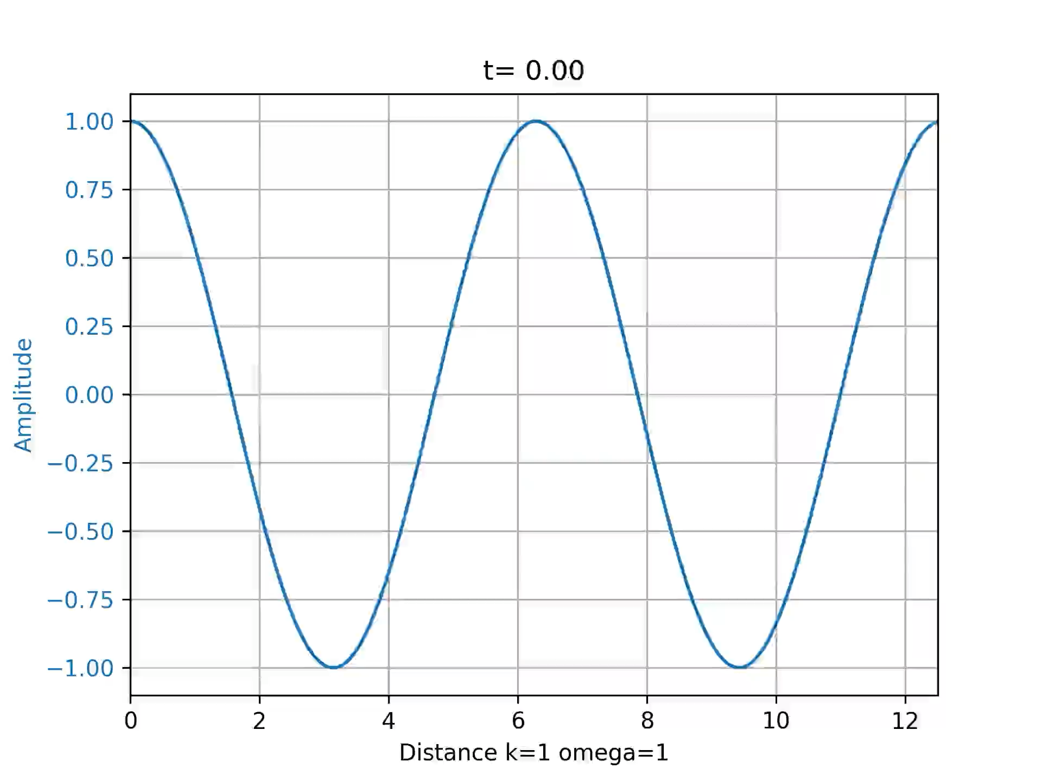
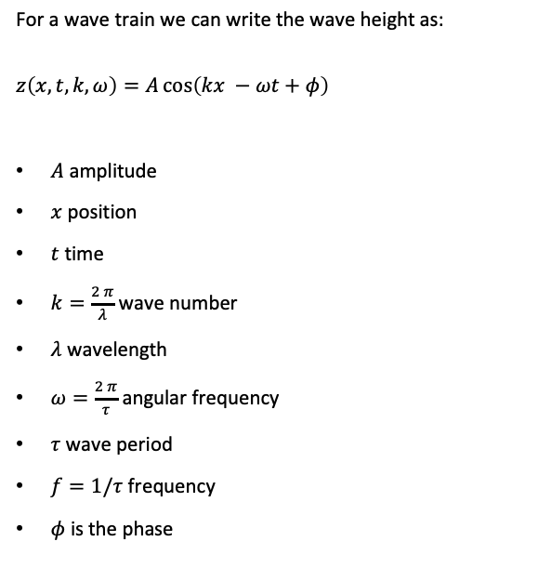
Wave Height
For a wave train we can write the wave height as:
$$z\left(x,t,k,ω\right)=A\cos\left(kx −ωt+φ\right)$$
$A$ amplitude
$x$ position
$t$ time
$k=\frac{2 π}{λ}$ wave number
$λ$ wavelength
$ω=\frac{2 π}{τ}$ angular frequency
$τ$ wave period
$f=1/τ$ frequency
$φ$ is the phase

Slide 3
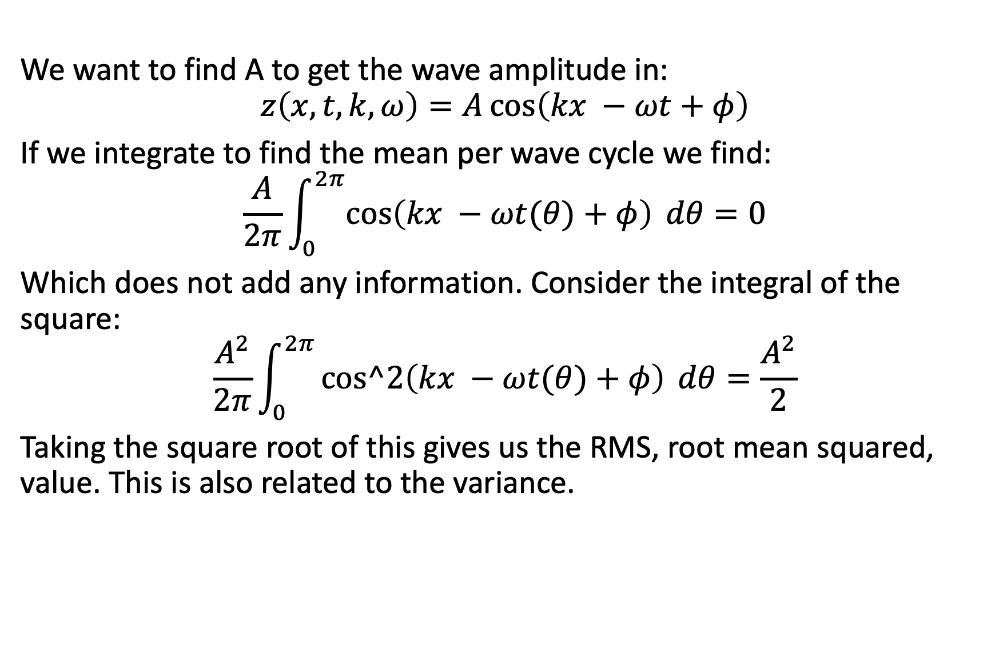
Wave Height Motivation
We want to find A to get the wave amplitude in:
$$z\left(x,t,k,ω\right)=A\cos\left(kx −ωt+φ\right)$$
If we integrate to find the mean per wave cycle we find:
$$\frac{A}{2π}\int_{0}^{2π}{\cos\left(kx −ωt(θ)+φ\right) dθ=0}$$
Which does not add any information. Consider the integral of the square:
$$\frac{A^{2}}{2π}\int_{0}^{2π}{cos^2\left(kx −ωt(θ)+φ\right) dθ=\frac{A^{2}}{2}}$$
Taking the square root of this gives us the RMS, root mean squared, value. This is also related to the variance.

Slide 4
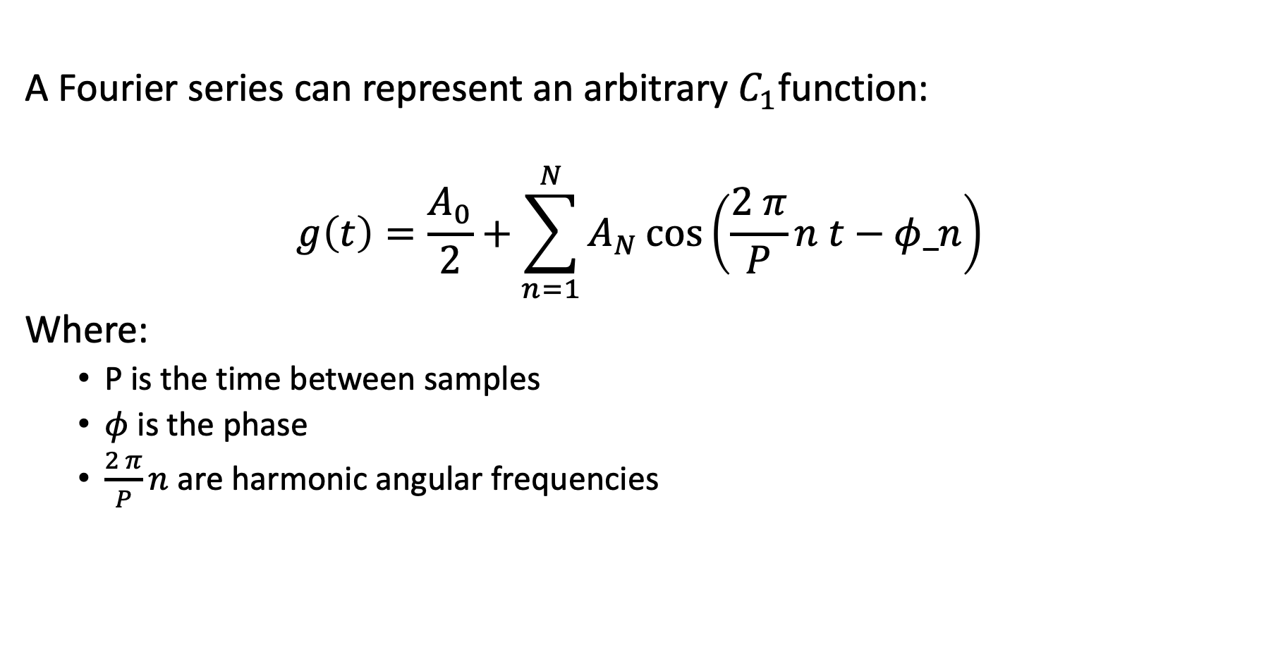
Fourier Series
A Fourier series can represent an arbitrary $C_{1}$function:
$$g\left(t\right)=\frac{A_{0}}{2}+\sum_{n=1}^{N}{A_{N}\cos\left(\frac{2 π}{P}n t−φ_n\right)}$$
Where:
P is the time between samples
$φ$ is the phase
$\frac{2 π}{P}n$ are harmonic angular frequencies

Slide 5
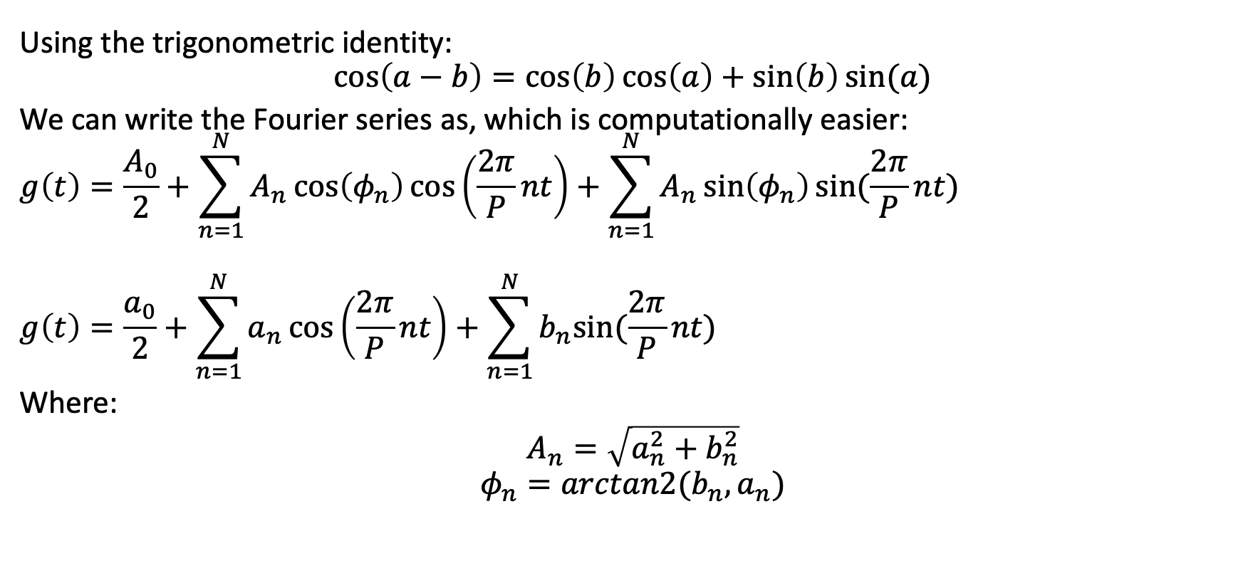
Fourier Series common representation
Using the trigonometric identity:
$$\cos\left(a−b\right)=\cos\left(b\right)\cos\left(a\right)+\sin\left(b\right)sin⁡(a)$$
We can write the Fourier series as, which is computationally easier:
$$g\left(t\right)=\frac{A_{0}}{2}+\sum_{n=1}^{N}{A_{n}\cos\left(φ_{n}\right)\cos\left(\frac{2π}{P}nt\right)+\sum_{n=1}^{N}{A_{n}\sin\left(φ_{n}\right)sin⁡(\frac{2π}{P}nt})}$$
$$g\left(t\right)=\frac{a_{0}}{2}+\sum_{n=1}^{N}{a_{n}\cos\left(\frac{2π}{P}nt\right)+\sum_{n=1}^{N}{b_{n}sin⁡(\frac{2π}{P}nt})}$$
Where:
$A_{n}=\sqrt{a_{n}^{2}+b_{n}^{2}}$
$$φ_{n}=arctan2(b_{n}, a_{n})$$

Slide 6
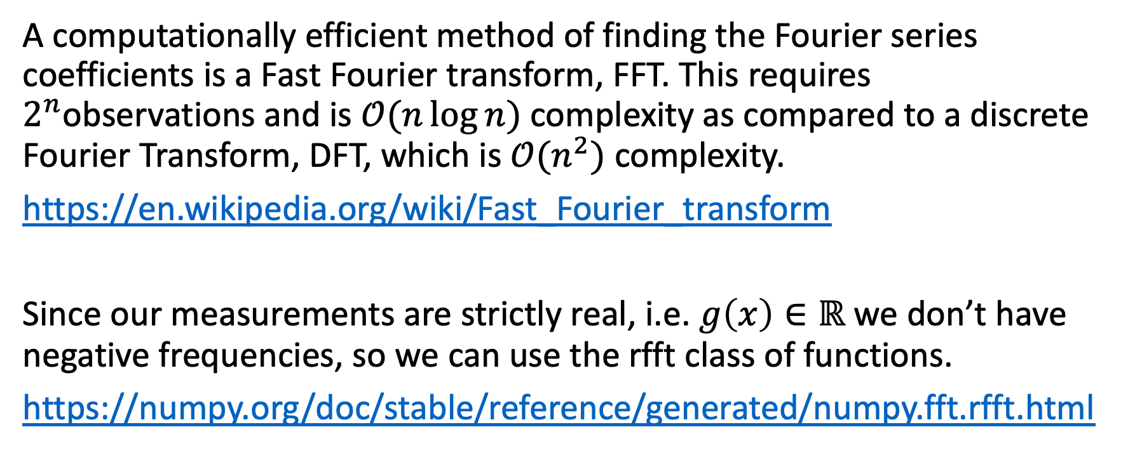
Solving Fourier Transform
A computationally efficient method of finding the Fourier series coefficients is a Fast Fourier transform, FFT. This requires $2^{n}$observations and is $𝒪(n\log{n)}$ complexity as compared to a discrete Fourier Transform, DFT, which is $𝒪(n^{2})$ complexity.
https://en.wikipedia.org/wiki/Fast_Fourier_transform
Since our measurements are strictly real, i.e. $g\left(x\right)∈ℝ$ we don’t have negative frequencies, so we can use the rfft class of functions.
https://numpy.org/doc/stable/reference/generated/numpy.fft.rfft.html

Slide 7
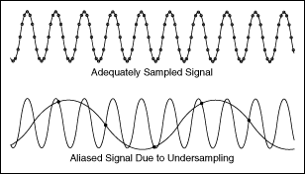
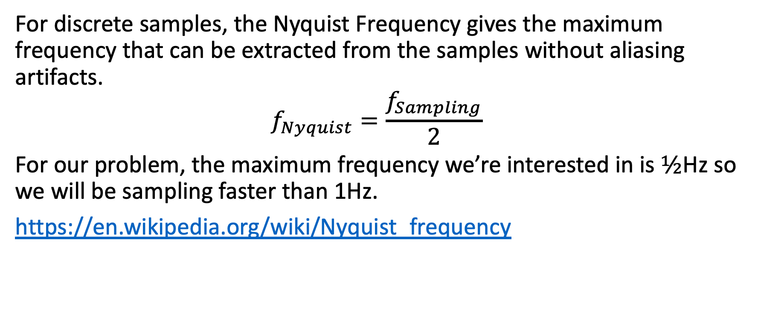
Nyquist Frequency
For discrete samples, the Nyquist Frequency gives the maximum frequency that can be extracted from the samples without aliasing artifacts.
$$f_{Nyquist}=\frac{f_{Sampling}}{2}$$
For our problem, the maximum frequency we’re interested in is $½$Hz so we will be sampling faster than 1Hz.
https://en.wikipedia.org/wiki/Nyquist_frequency

Slide 8
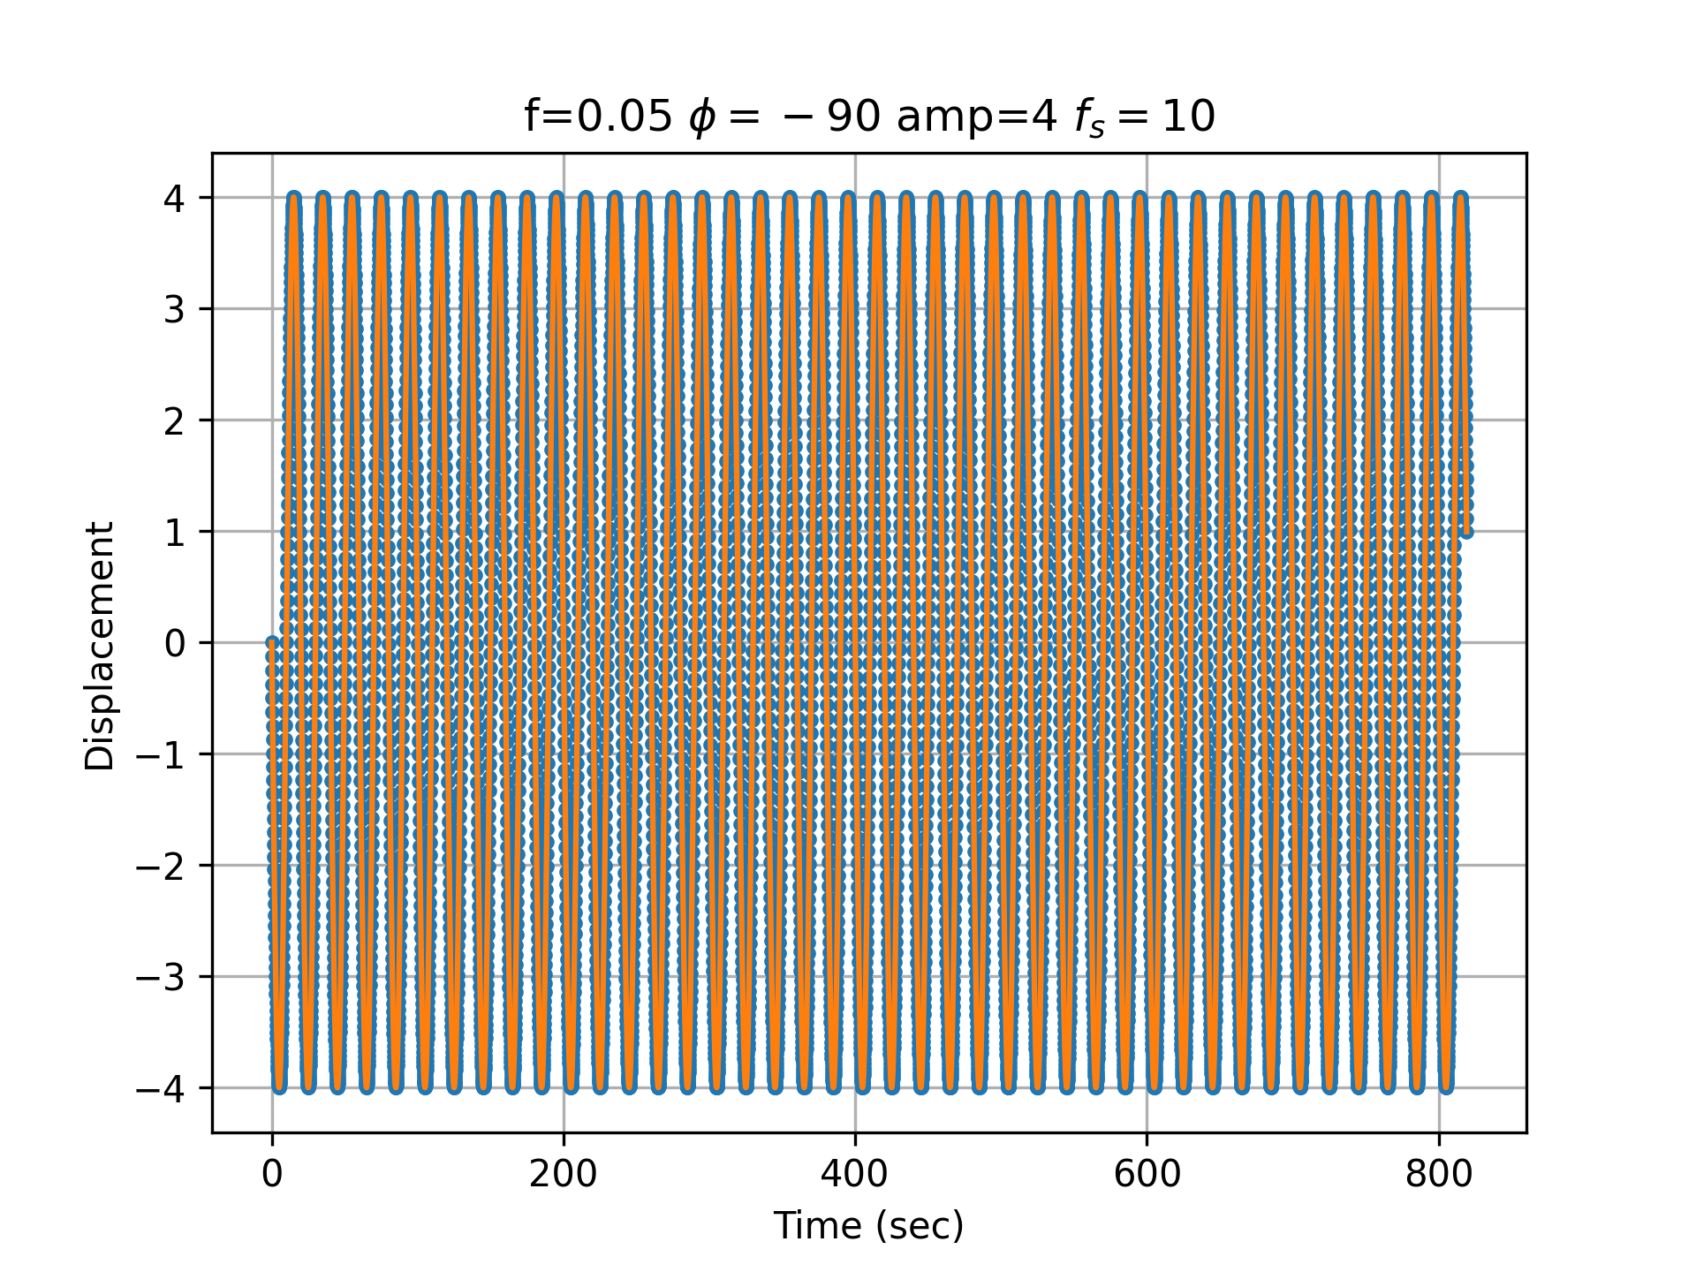
Example
Let’s consider a single sine wave:
Period 20 seconds
Phase -90 degrees
Amplitude 4
Sampling at 10Hz
8192 samples

Slide 9
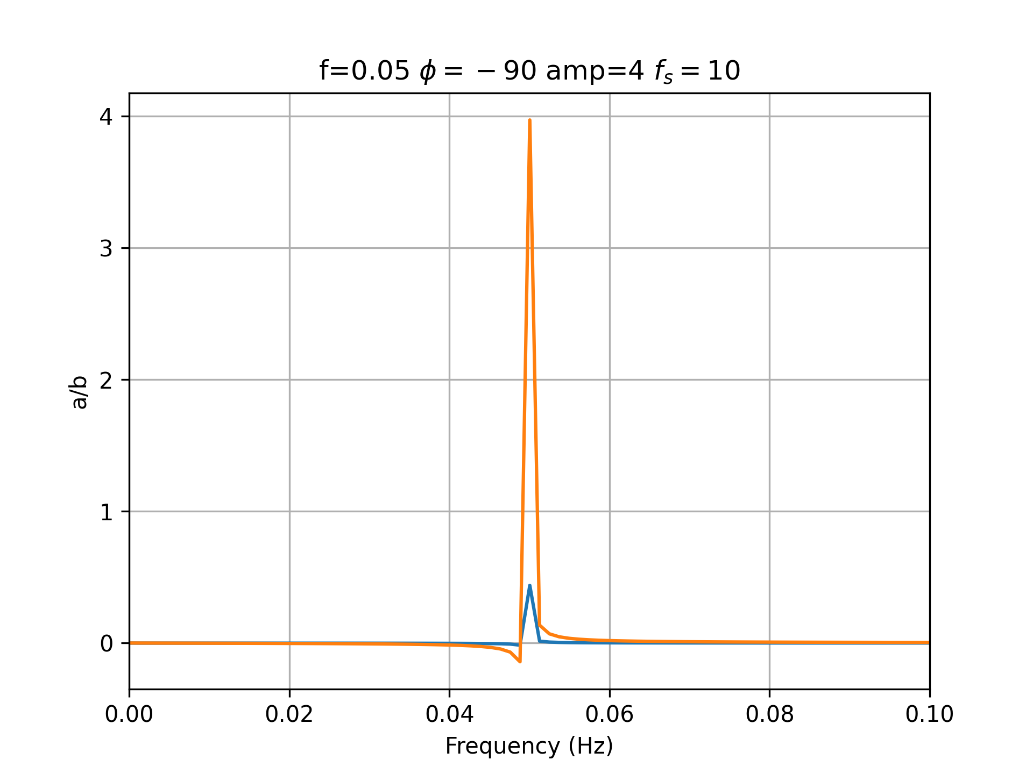
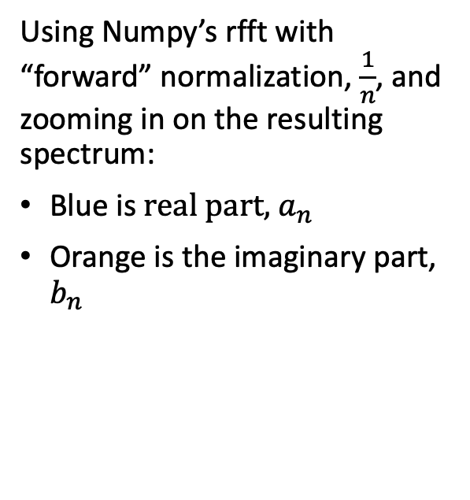
Example RFFT
Using Numpy’s rfft with “forward” normalization, $\frac{1}{n}$, and zooming in on the resulting spectrum:
Blue is $real part,$ $a_{n}$
Orange is the imaginary part, $b_{n}$

Slide 10
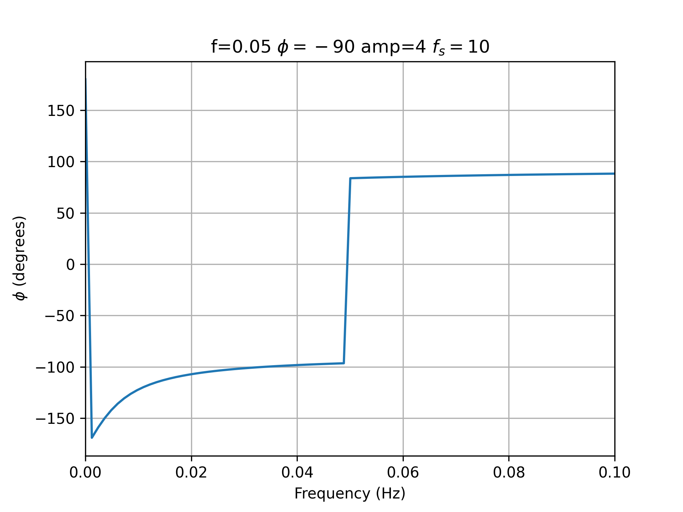
Example Phase
Phase from np.angle, arctan2

Slide 11
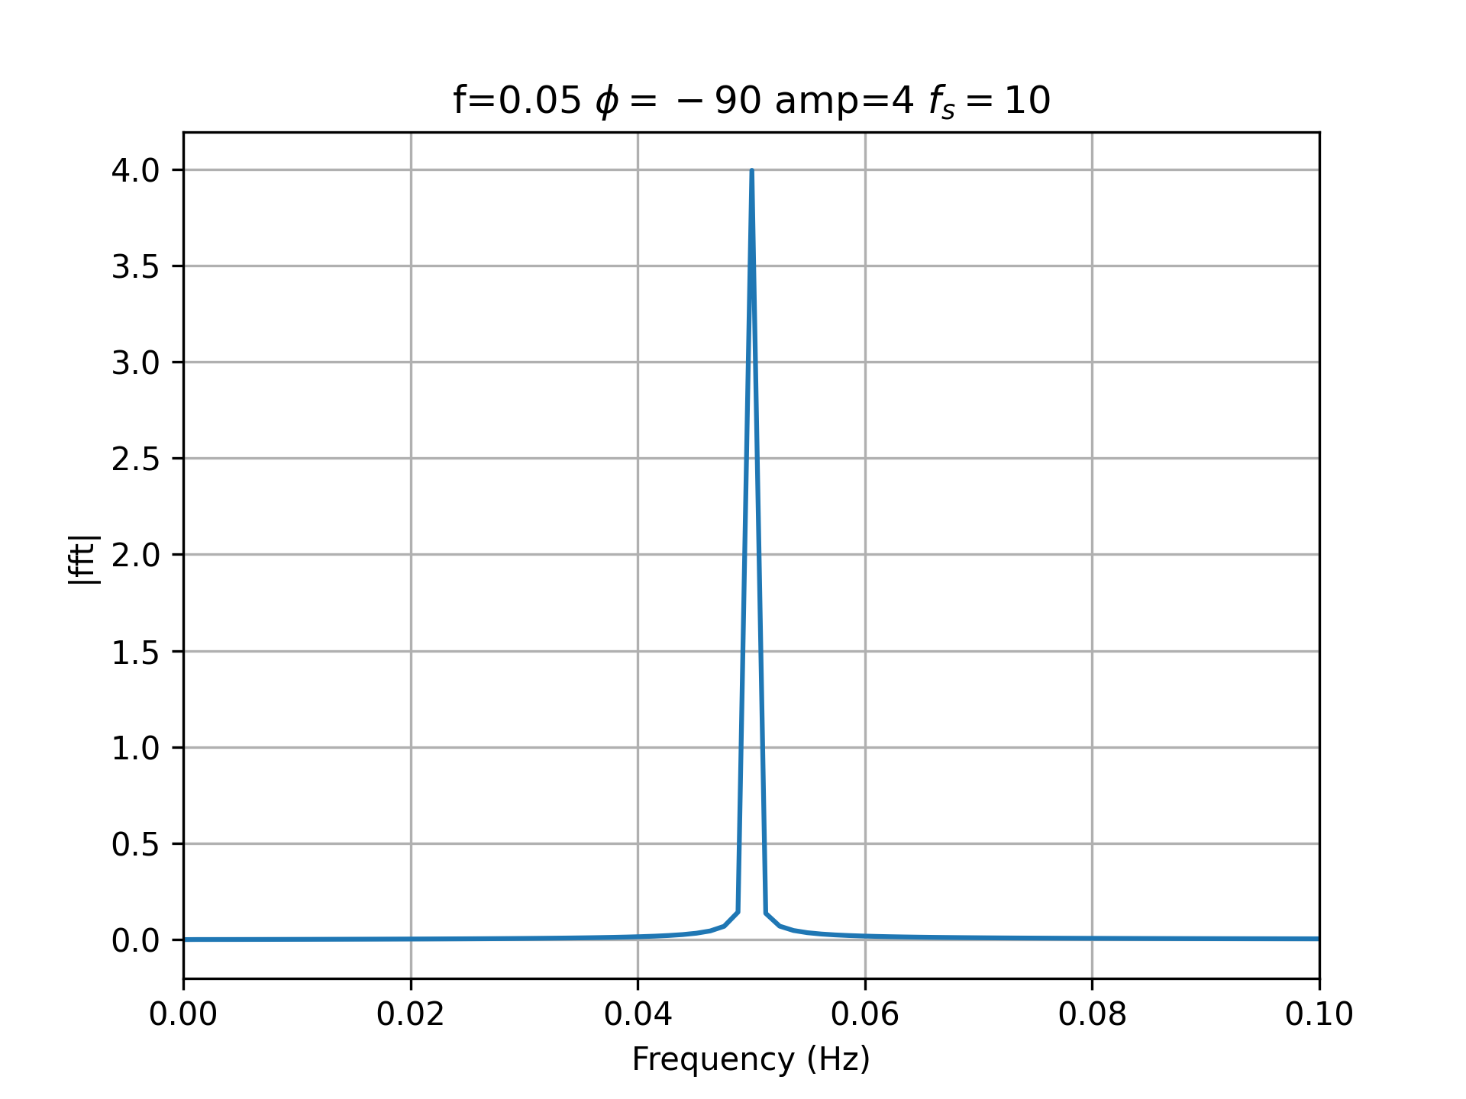
Example Amplitude
Amplitude, np.abs

Slide 12
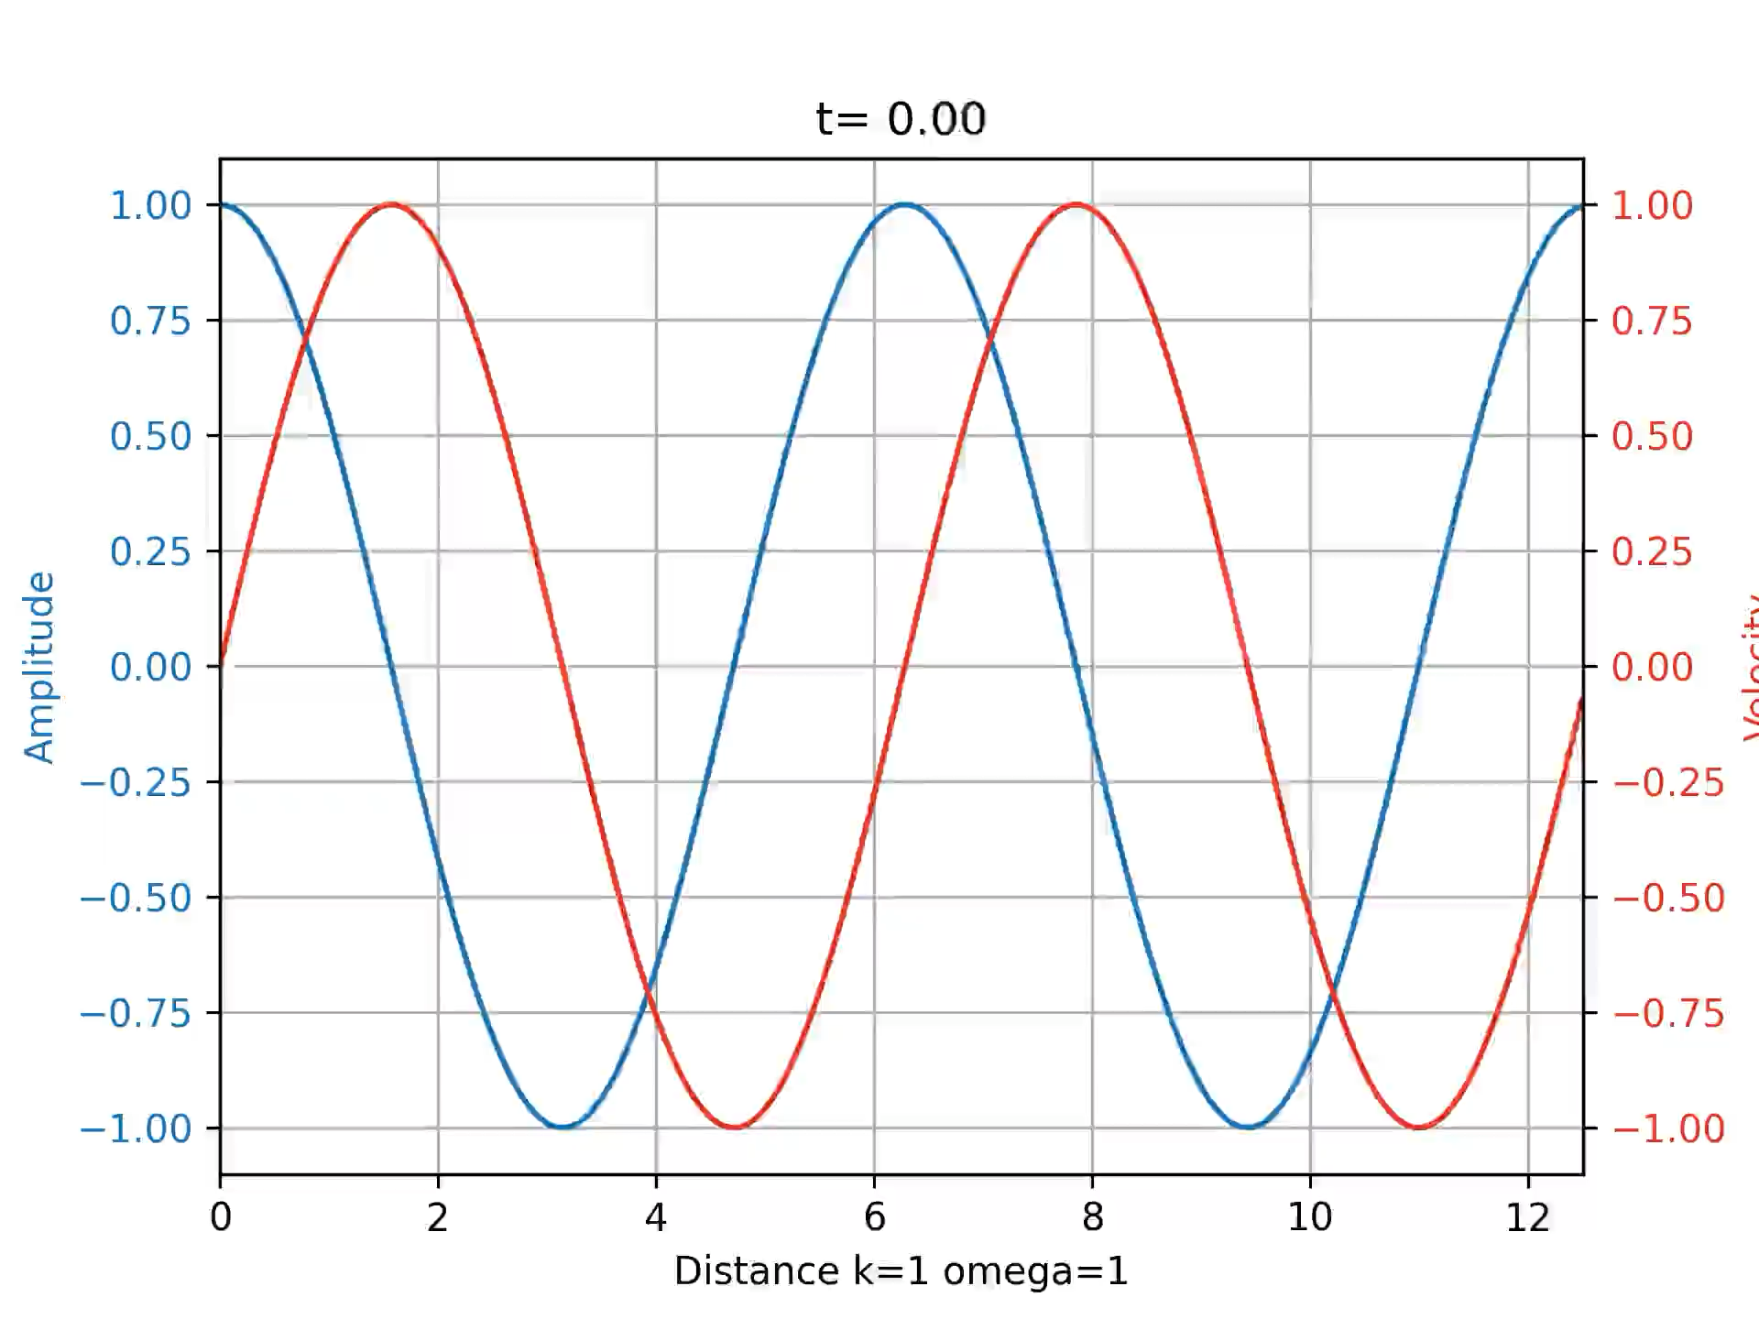
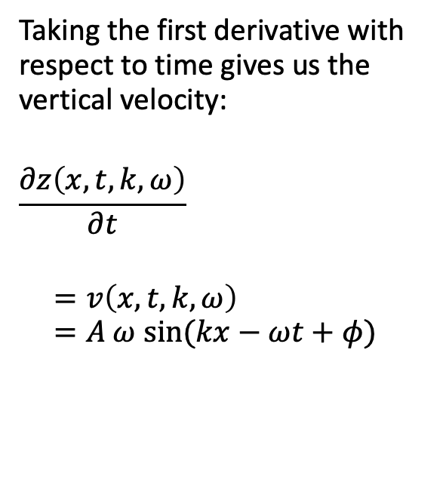
Wave Velocity
Taking the first derivative with respect to time gives us the vertical velocity:
$$\frac{∂z\left(x,t,k,ω\right)}{∂t}$$ $$=v\left(x,t,k,ω\right)$$ $=A ω sin⁡(kx−ωt+φ)$

Slide 13
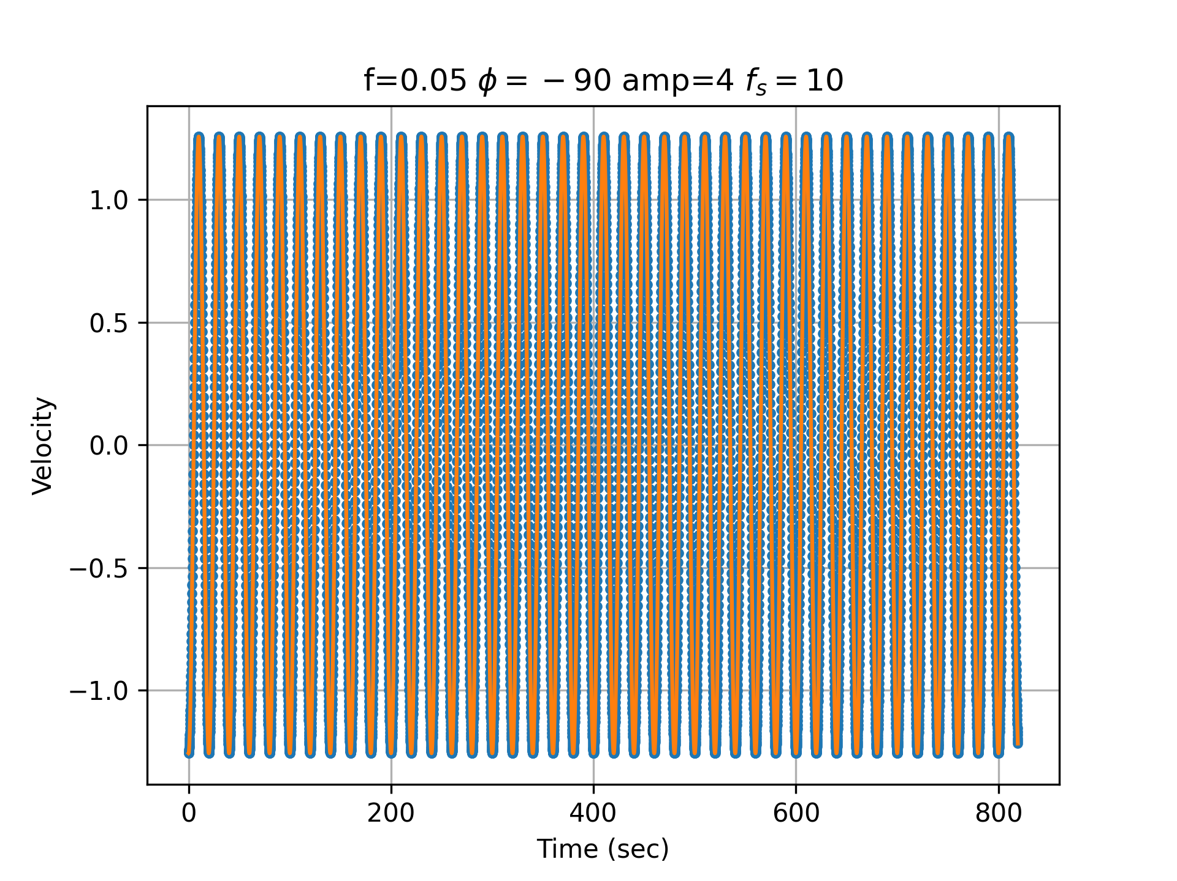
Example Velocity
Let’s consider a single sine wave:
Period 20 seconds
Phase -90 degrees
Amplitude 4
Sampling at 10Hz
8192 samples

Slide 14
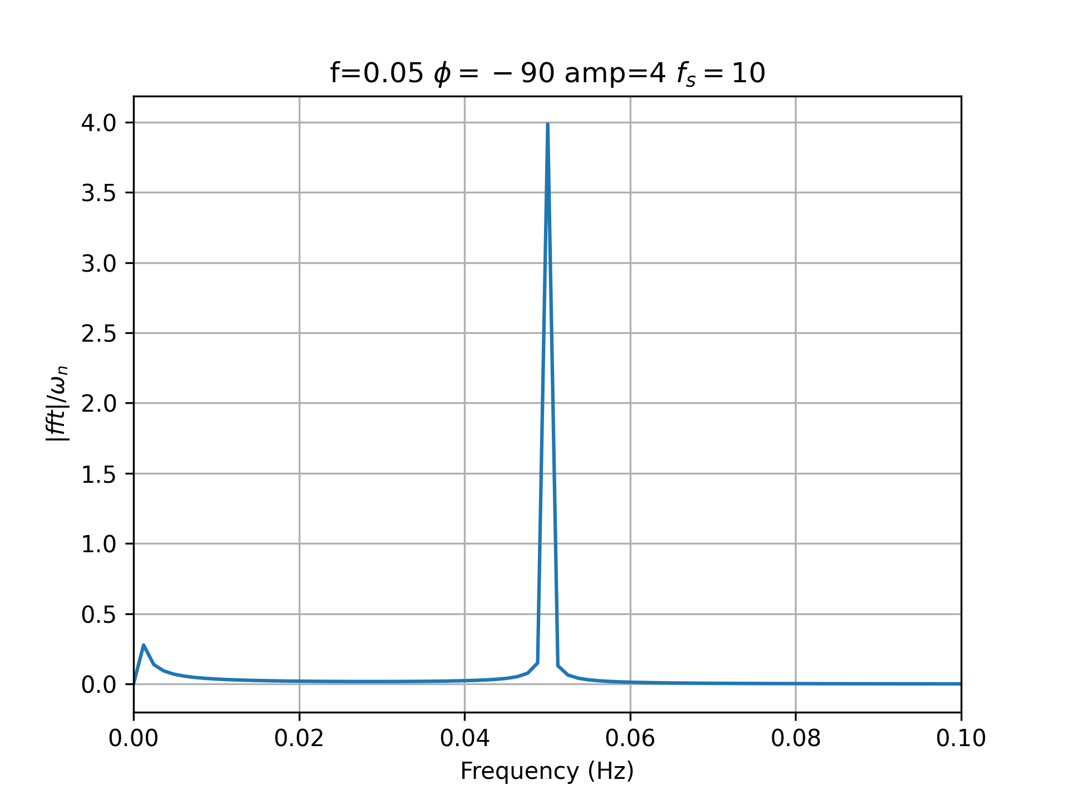
Example Velocity Amplitude
Amplitude, np.abs, over angular frequency

Slide 15
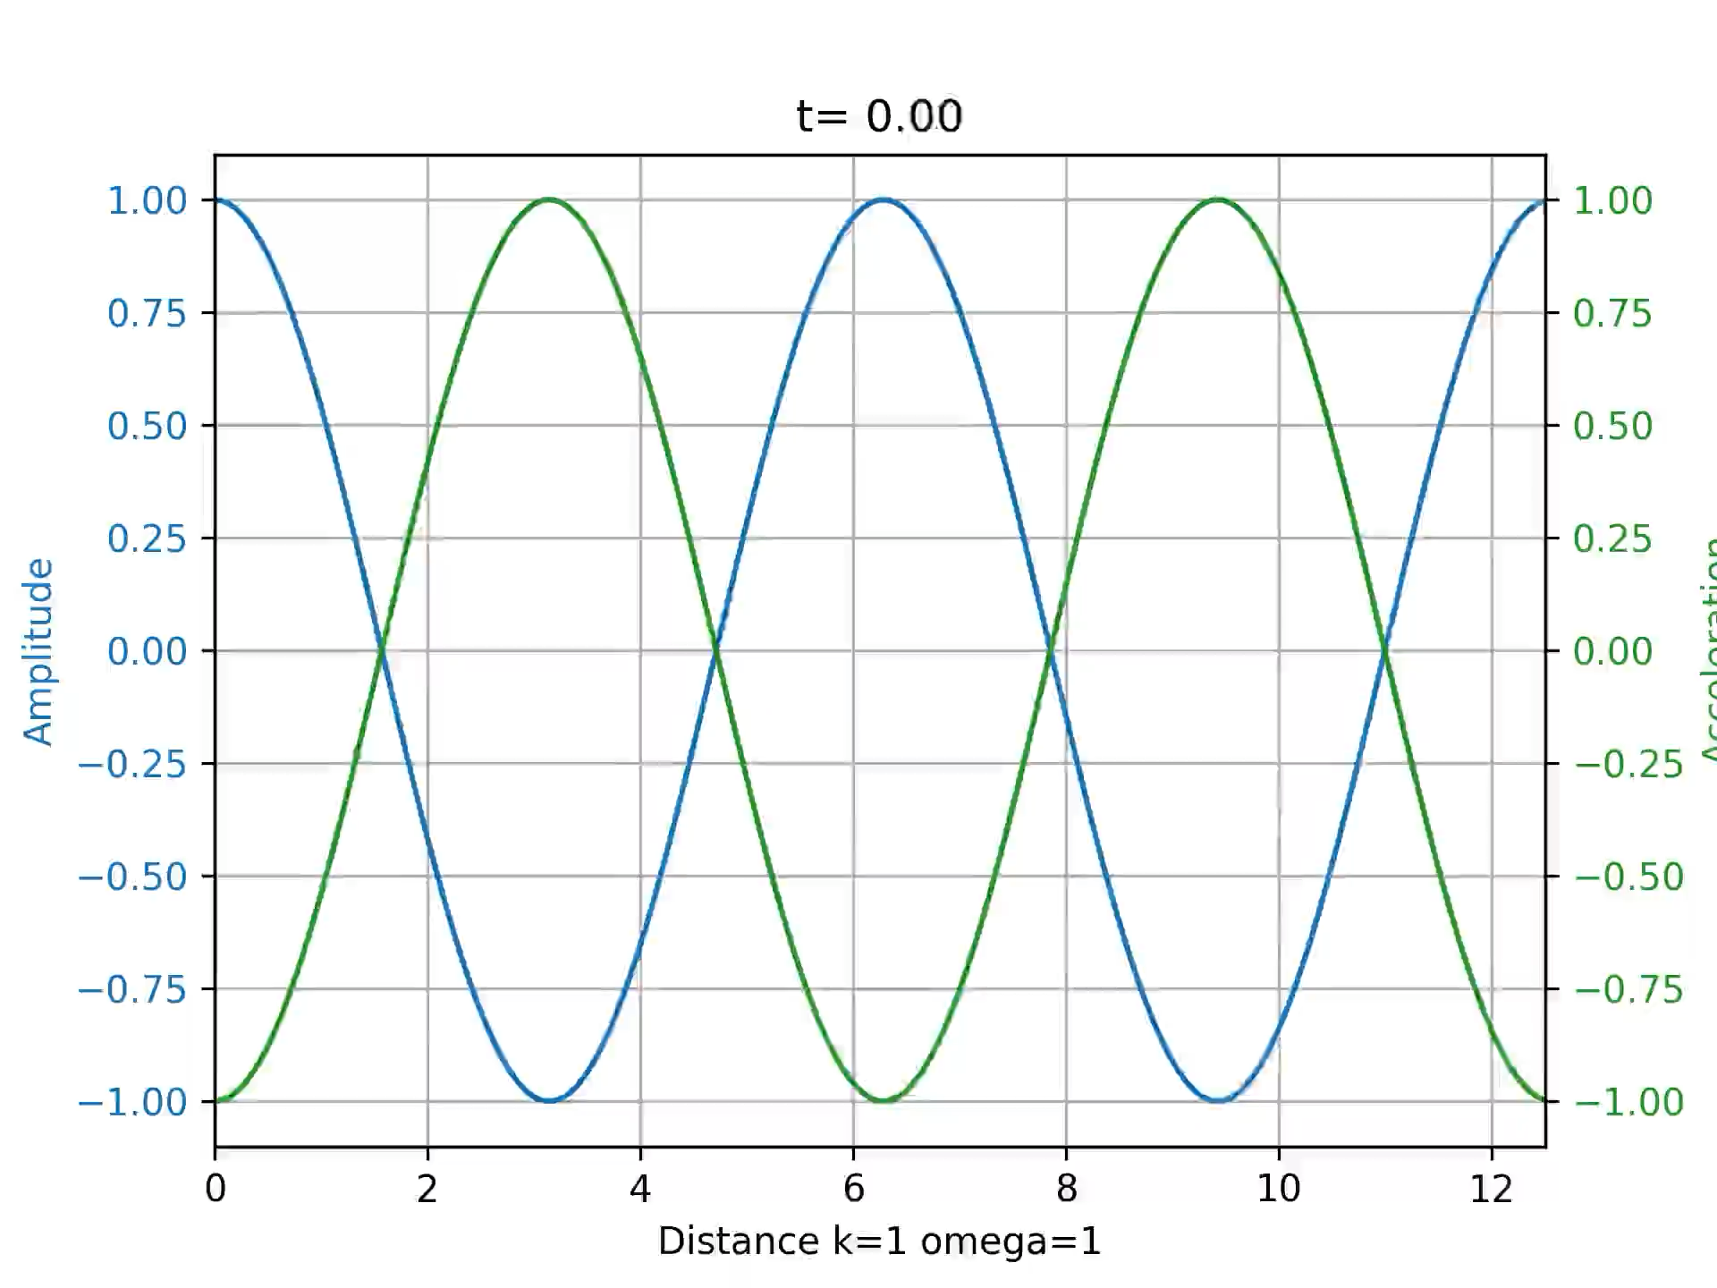
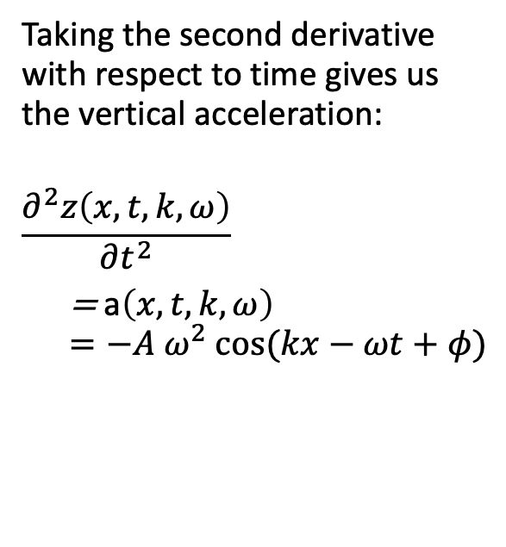
Wave Acceleration
Taking the second derivative with respect to time gives us the vertical acceleration:
$$\frac{∂^{2}z\left(x,t,k,ω\right)}{∂t^{2}}$$ = a$\left(x,t,k,ω\right)$ $=−A ω^{2} cos⁡(kx−ωt+φ)$

Slide 16
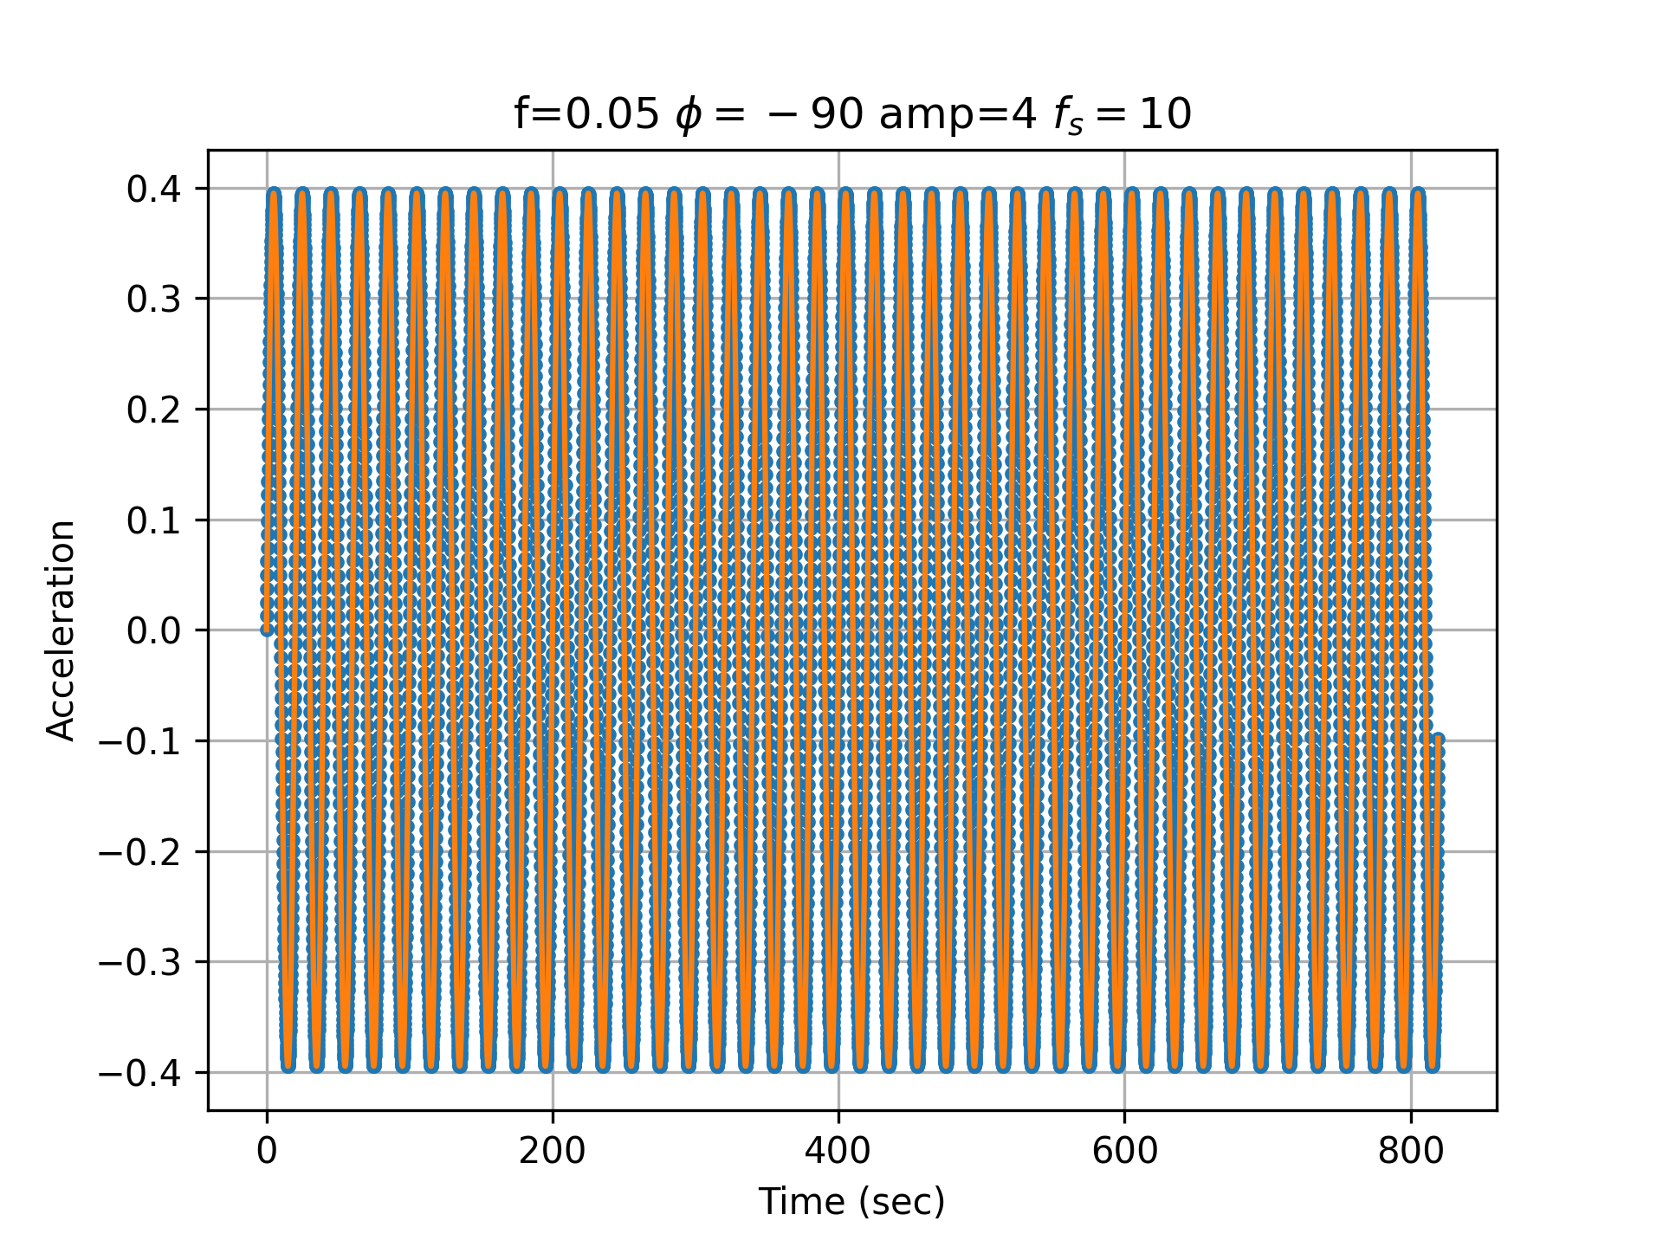
Example Acceleration
Let’s consider a single sine wave:
Period 20 seconds
Phase -90 degrees
Amplitude 4
Sampling at 10Hz
8192 samples

Slide 17
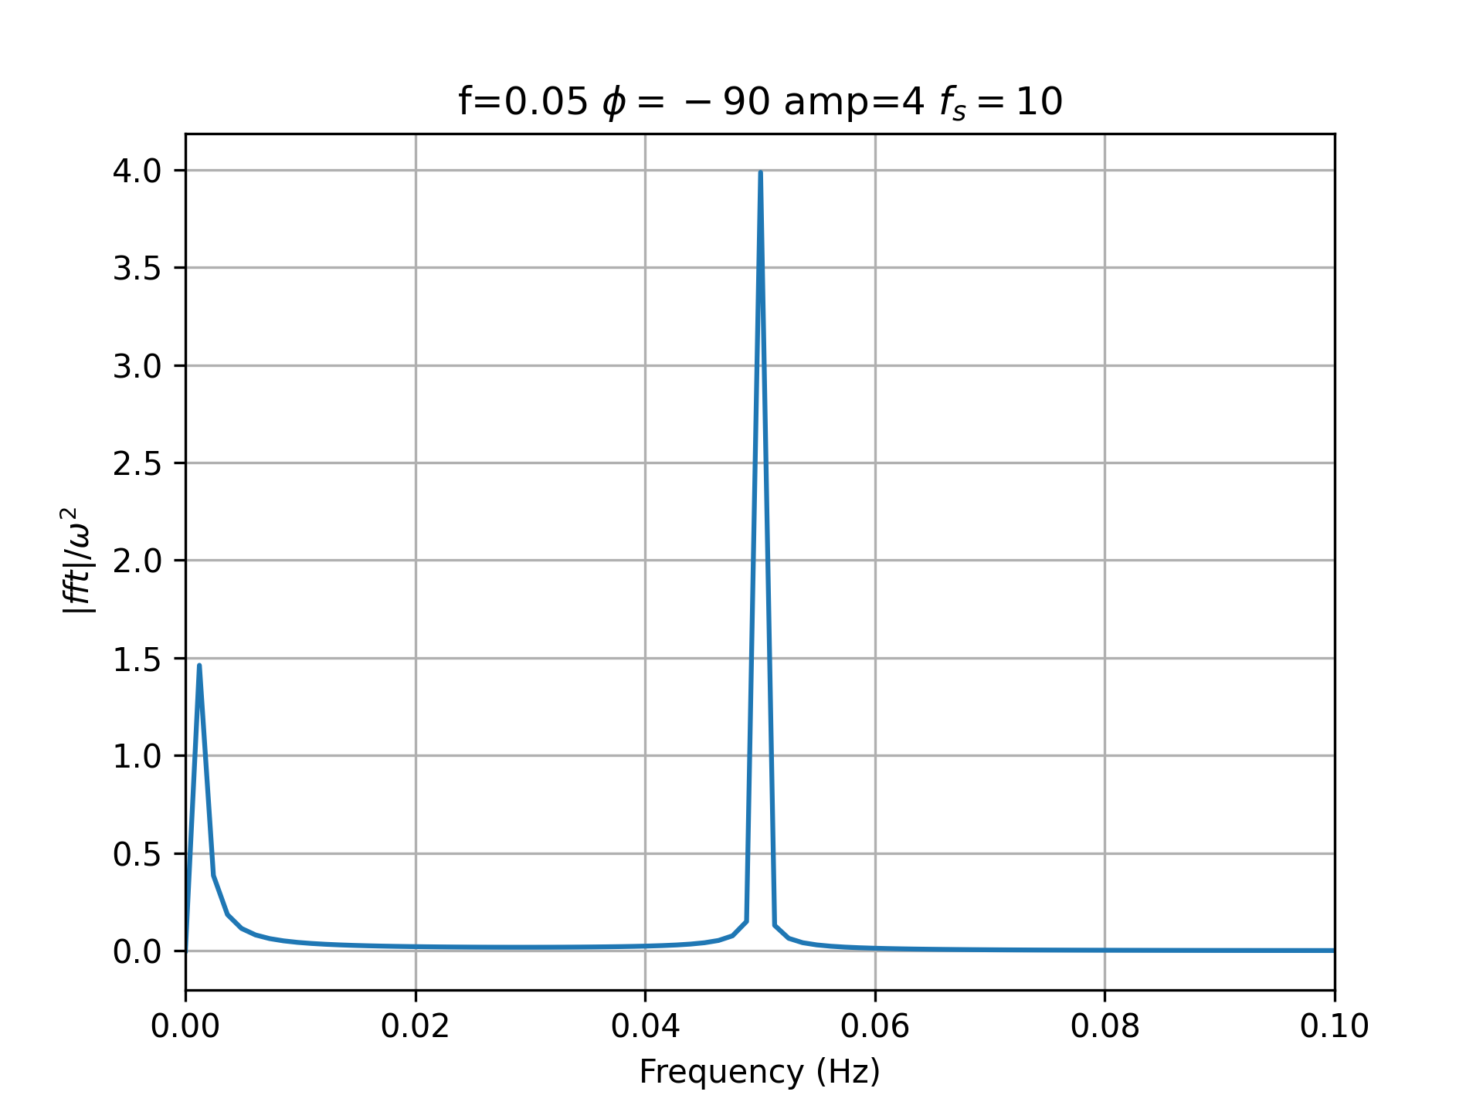
Example Acceleration Amplitude
Amplitude, np.abs, over angular frequency squared

Slide 18
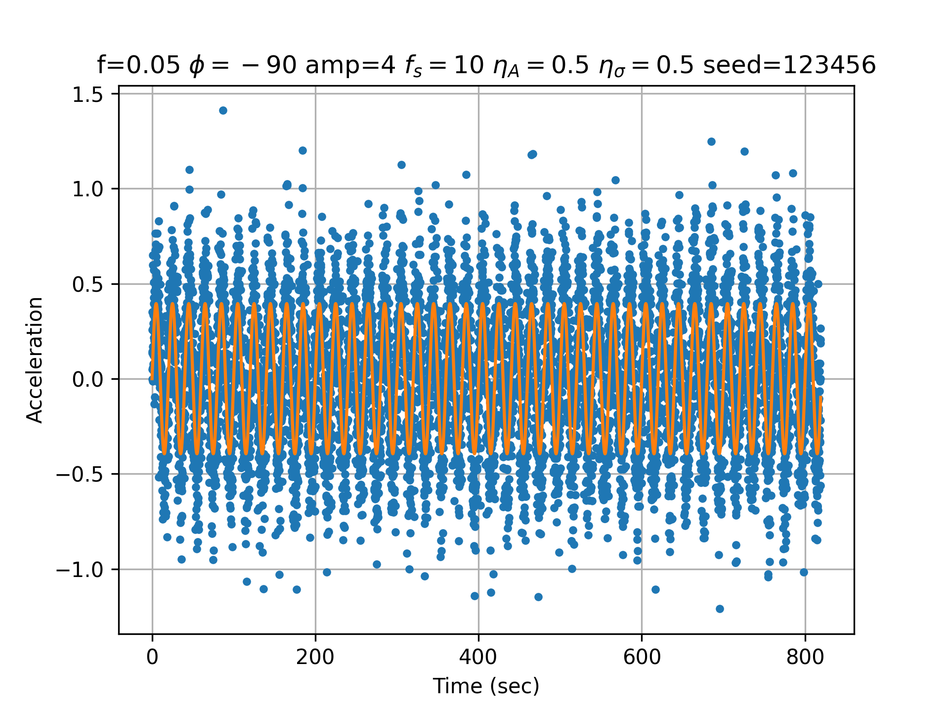
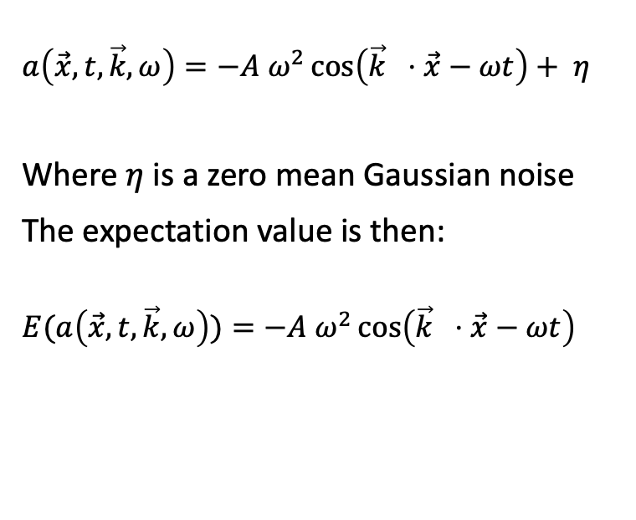
Acceleration Measurement with Noise
$$a\left(\vec{x},t,\vec{k},ω\right)=−A ω^{2}\cos\left(\vec{k} ⋅\vec{x}−ωt\right)+ η$$
Where $η$ is a zero mean Gaussian noise
The expectation value is then:
$$E(a\left(\vec{x},t,\vec{k},ω\right))=−A ω^{2}\cos\left(\vec{k} ⋅\vec{x}−ωt\right)$$

Slide 19
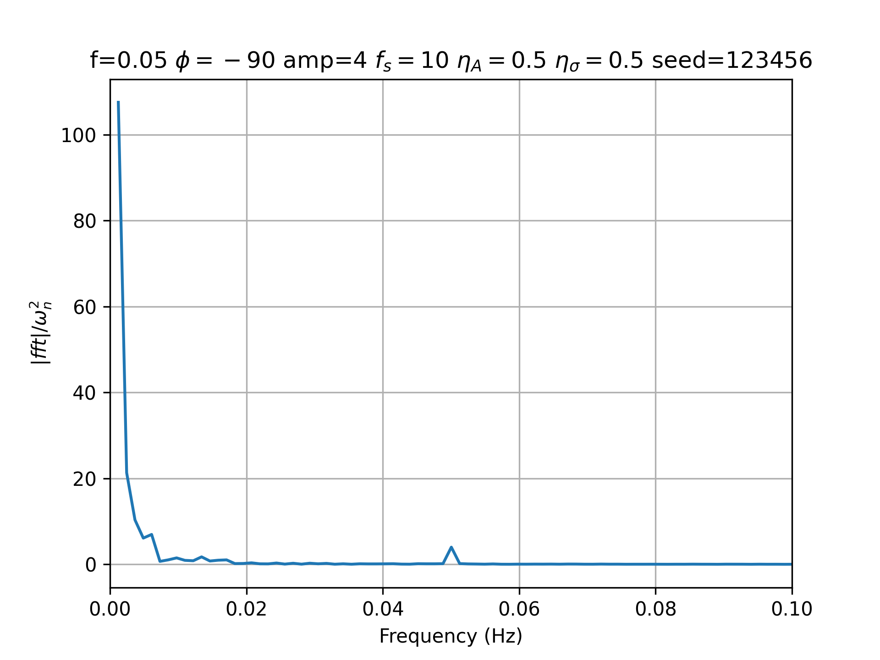
Noisy Acceleration Amplitude
Amplitude, np.abs, over angular frequency squared

Slide 20
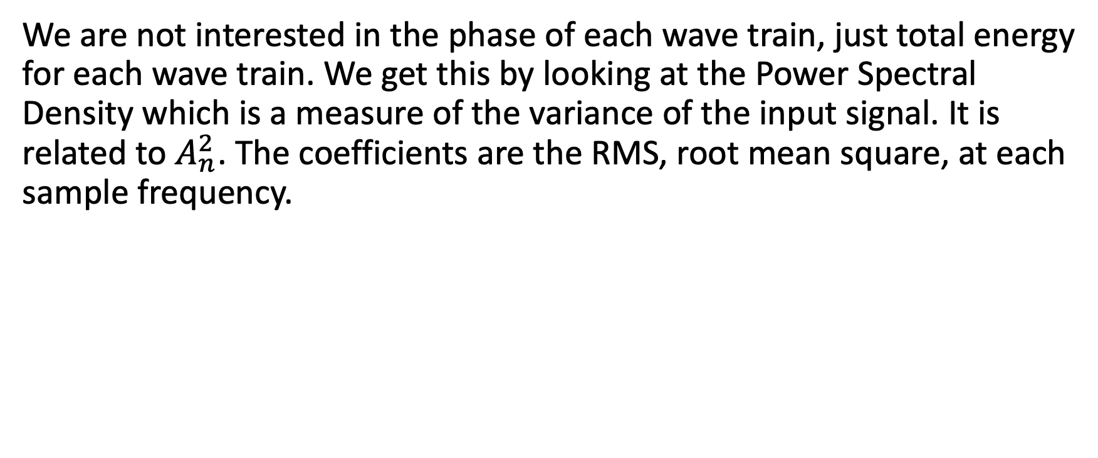
Power Spectral Density
We are not interested in the phase of each wave train, just total energy for each wave train. We get this by looking at the Power Spectral Density which is a measure of the variance of the input signal. It is related to $A_{n}^{2}$. The coefficients are the RMS, root mean square, at each sample frequency.

Slide 21
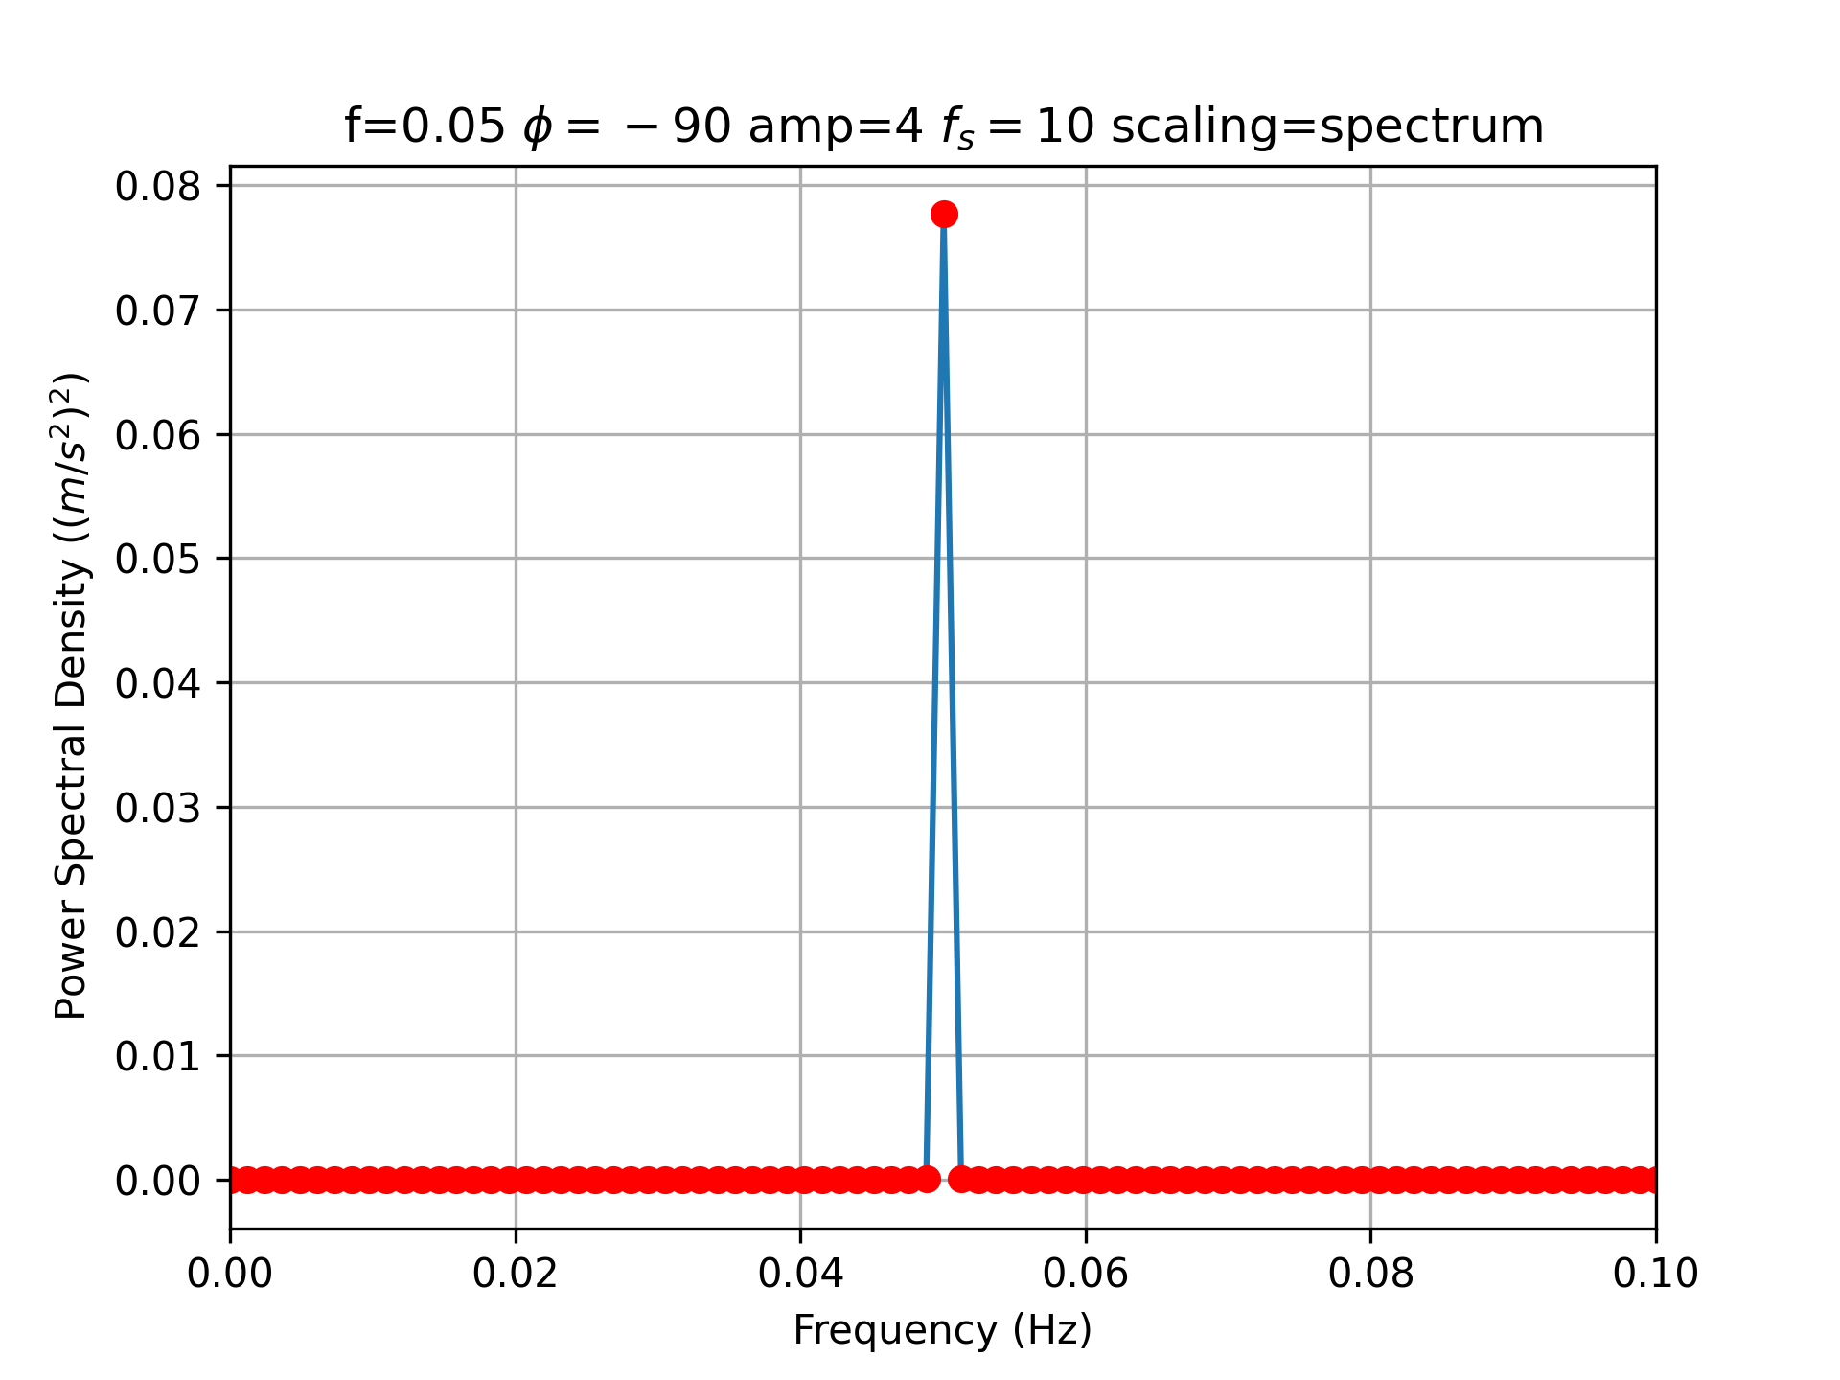
Noiseless Periodogram
scipy.signal.periodogram

Slide 22
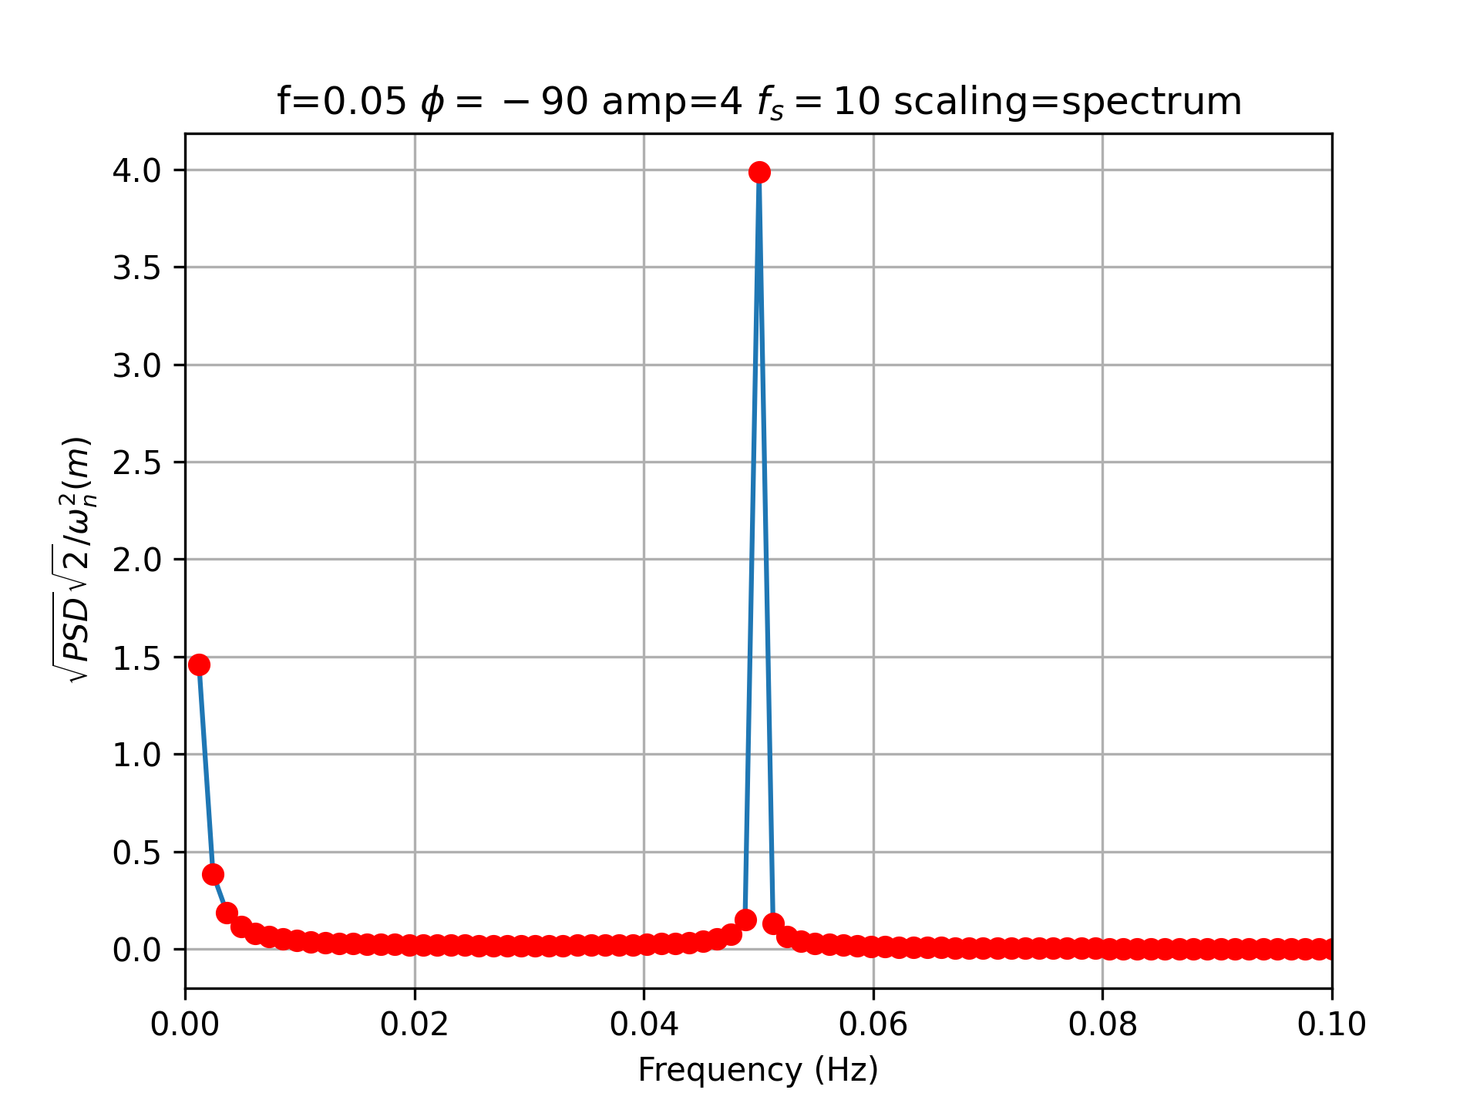
Noiseless Periodogram Normalized
scipy.signal.periodogram

Slide 23
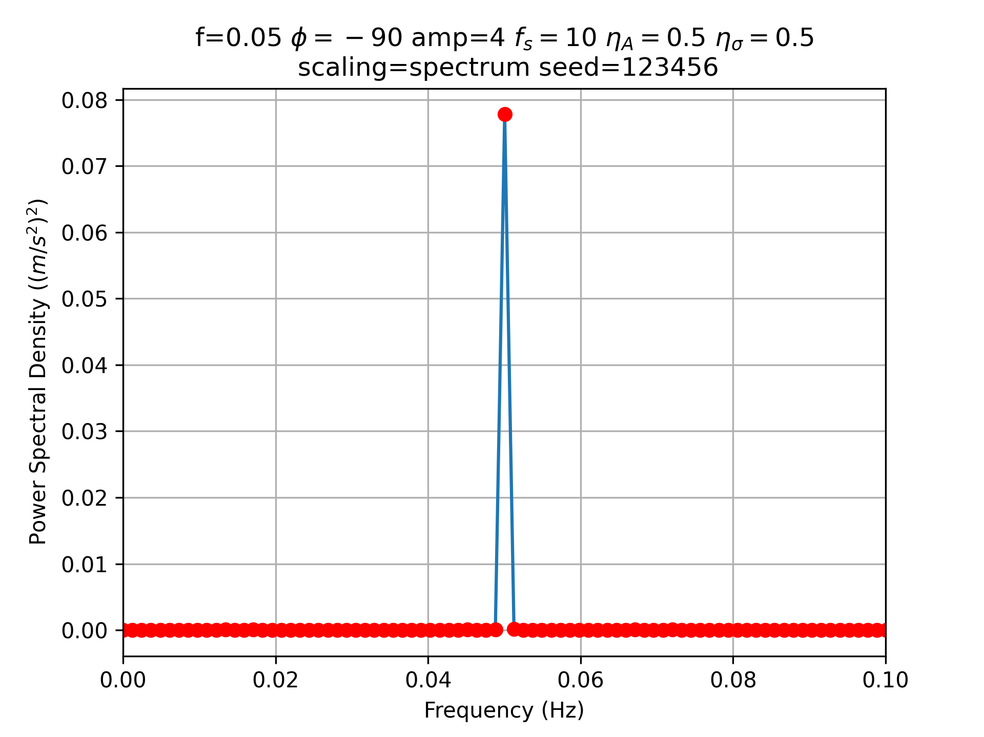
Noisy Periodogram
scipy.signal.periodogram

Slide 24
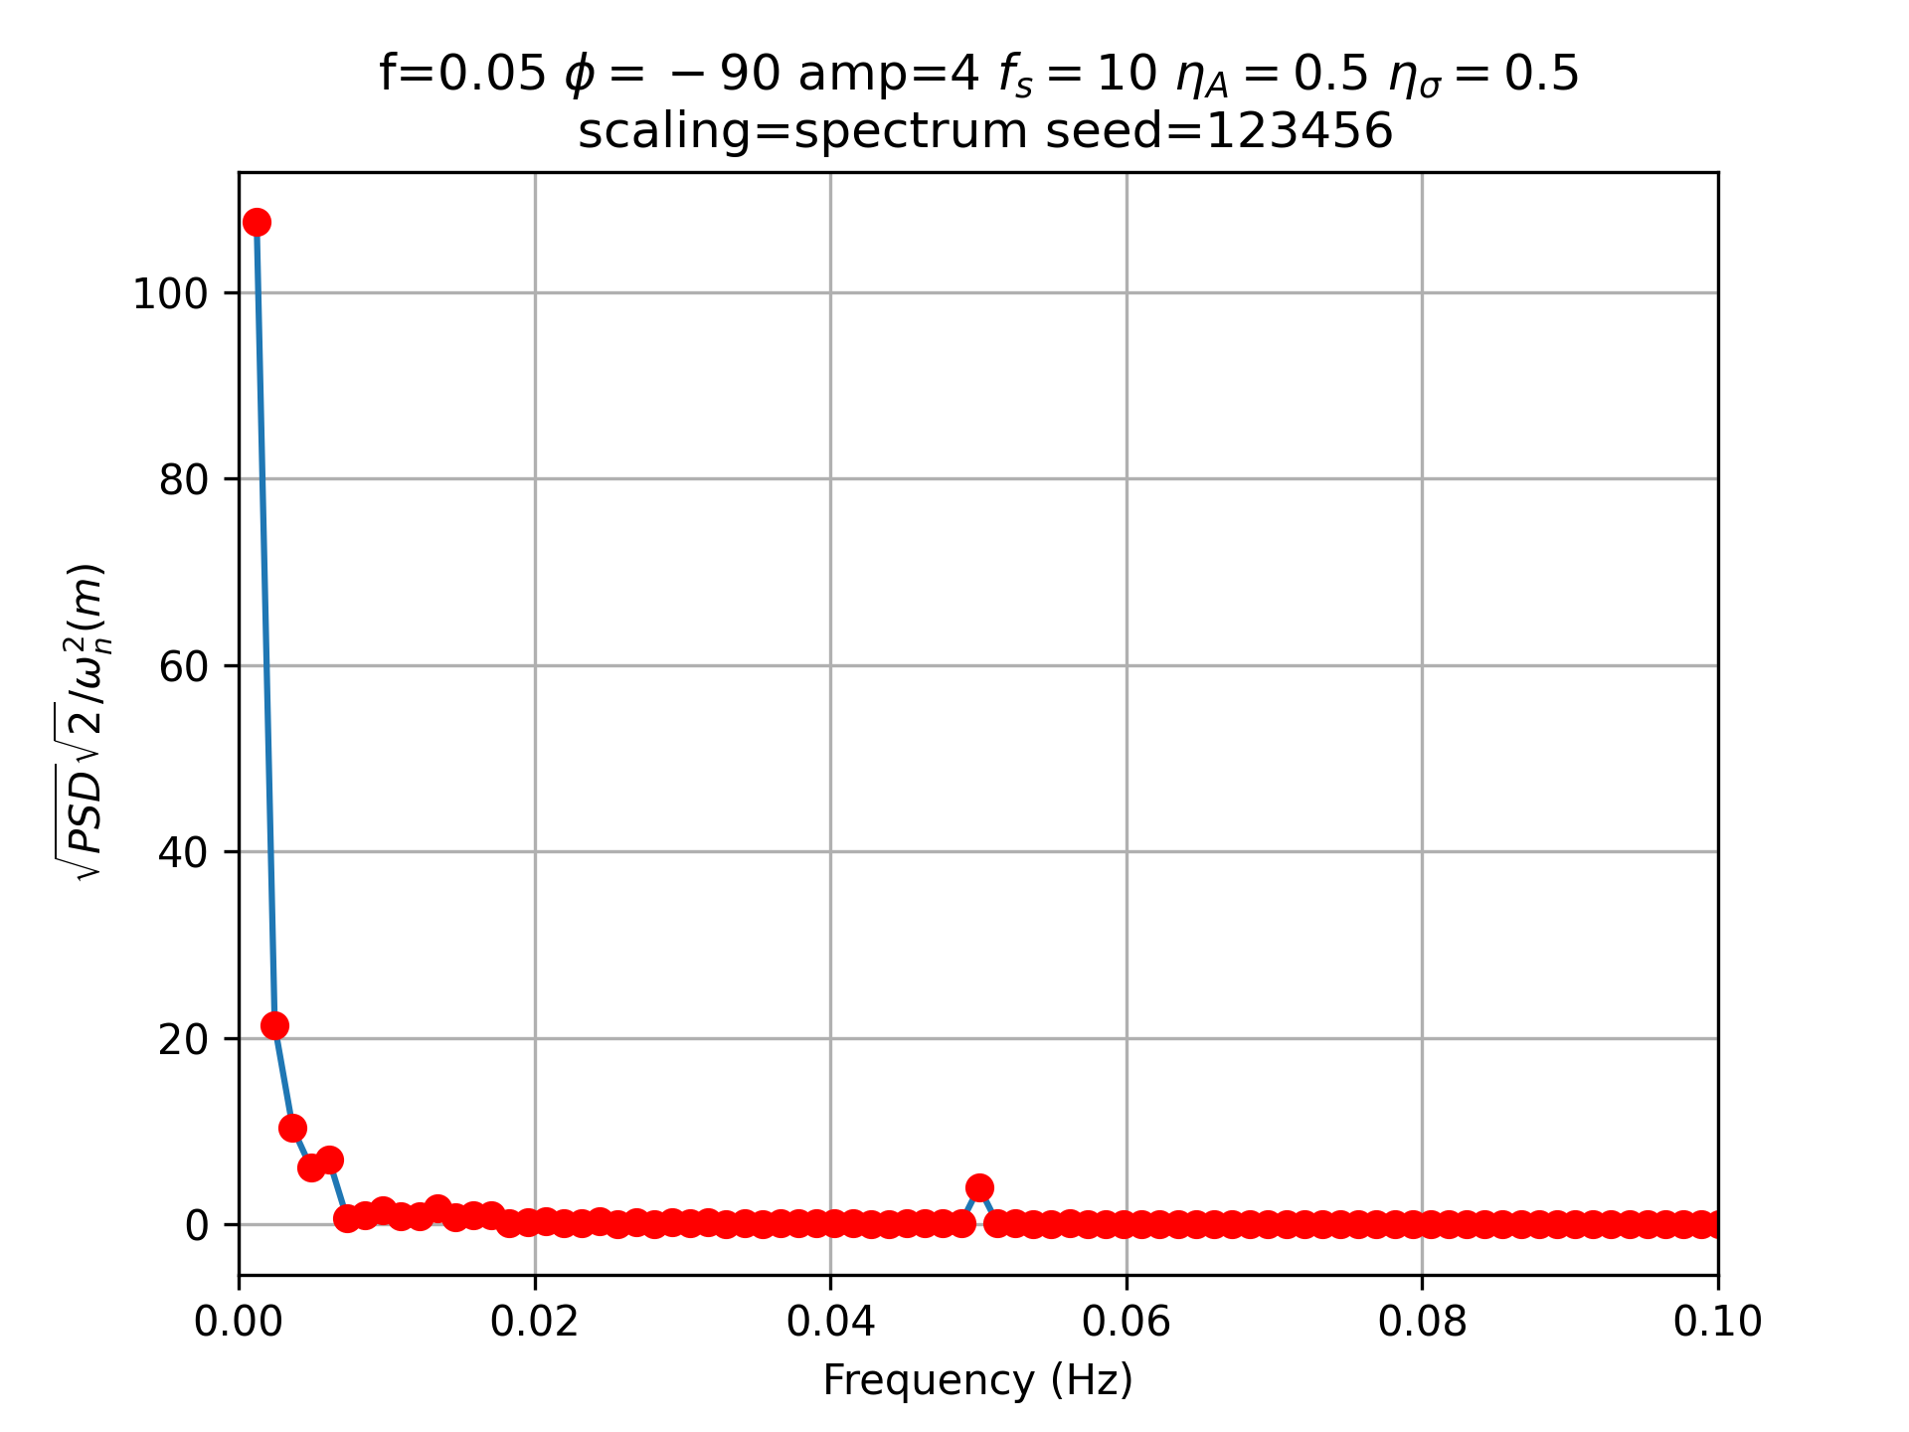
Noisy Periodogram Normalized
scipy.signal.periodogram

Slide 25
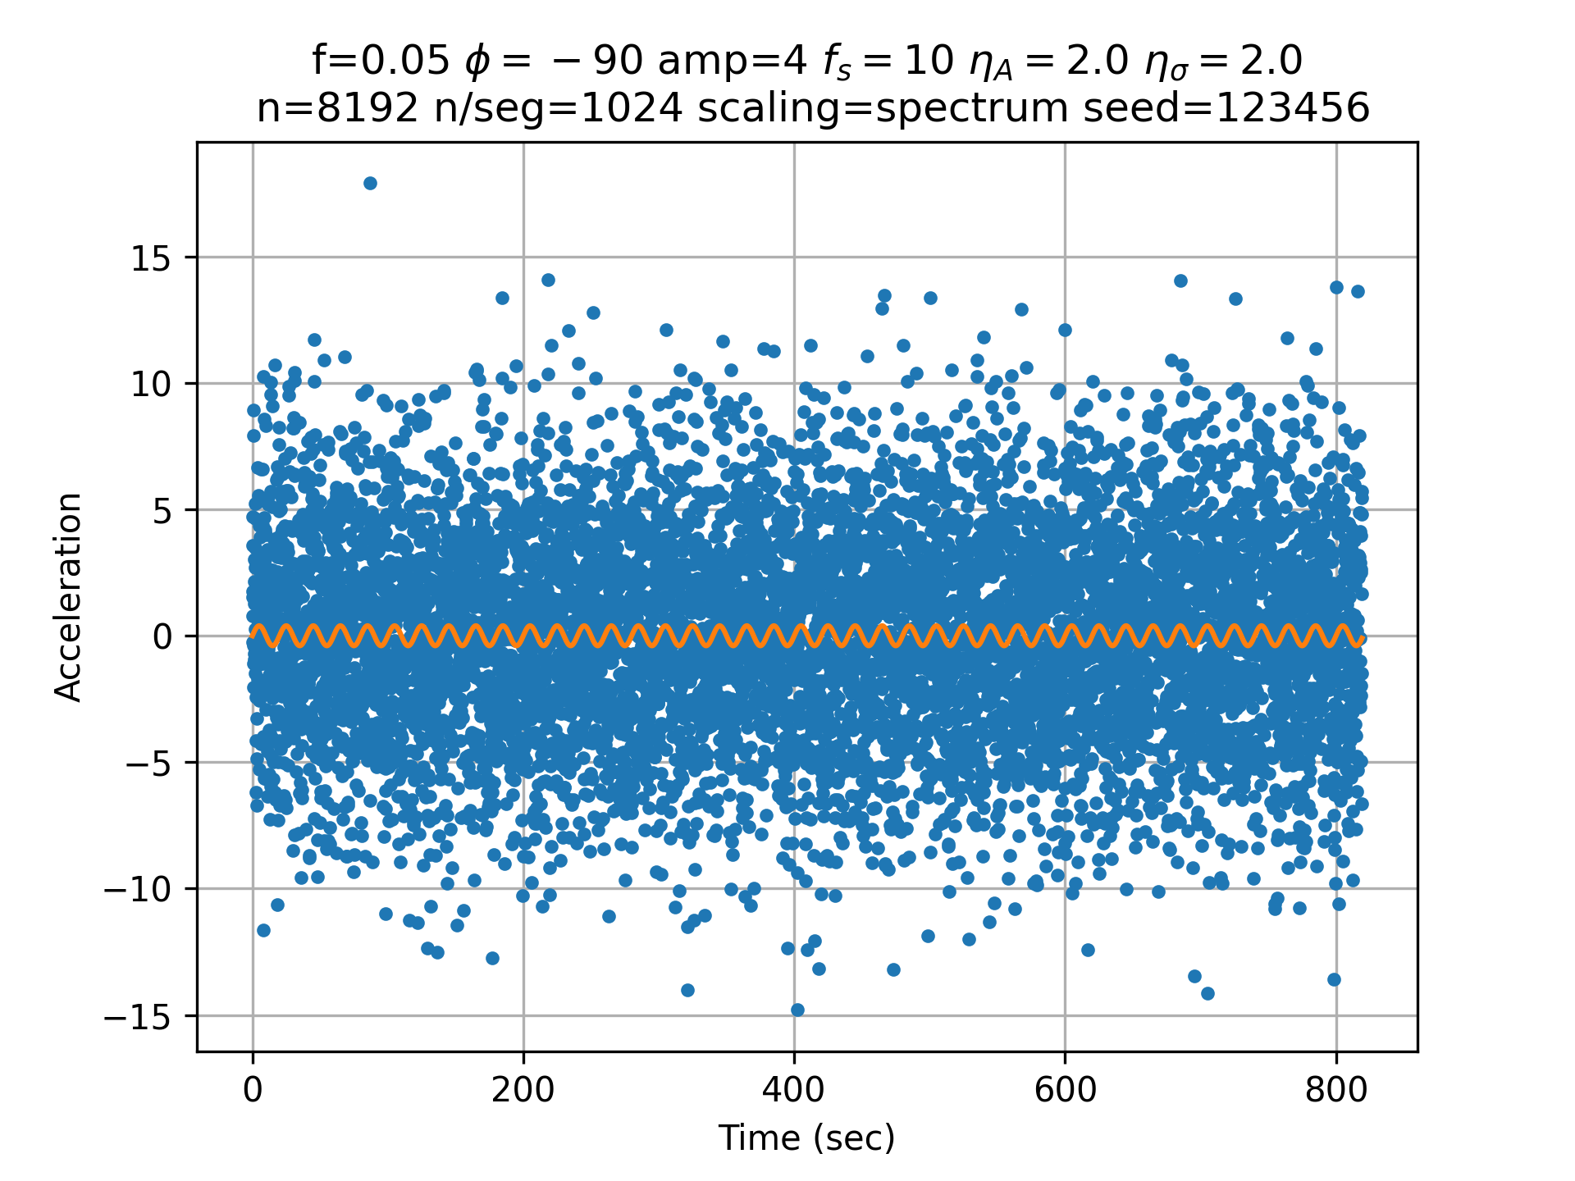
Very Noisy Spectrum

Slide 26
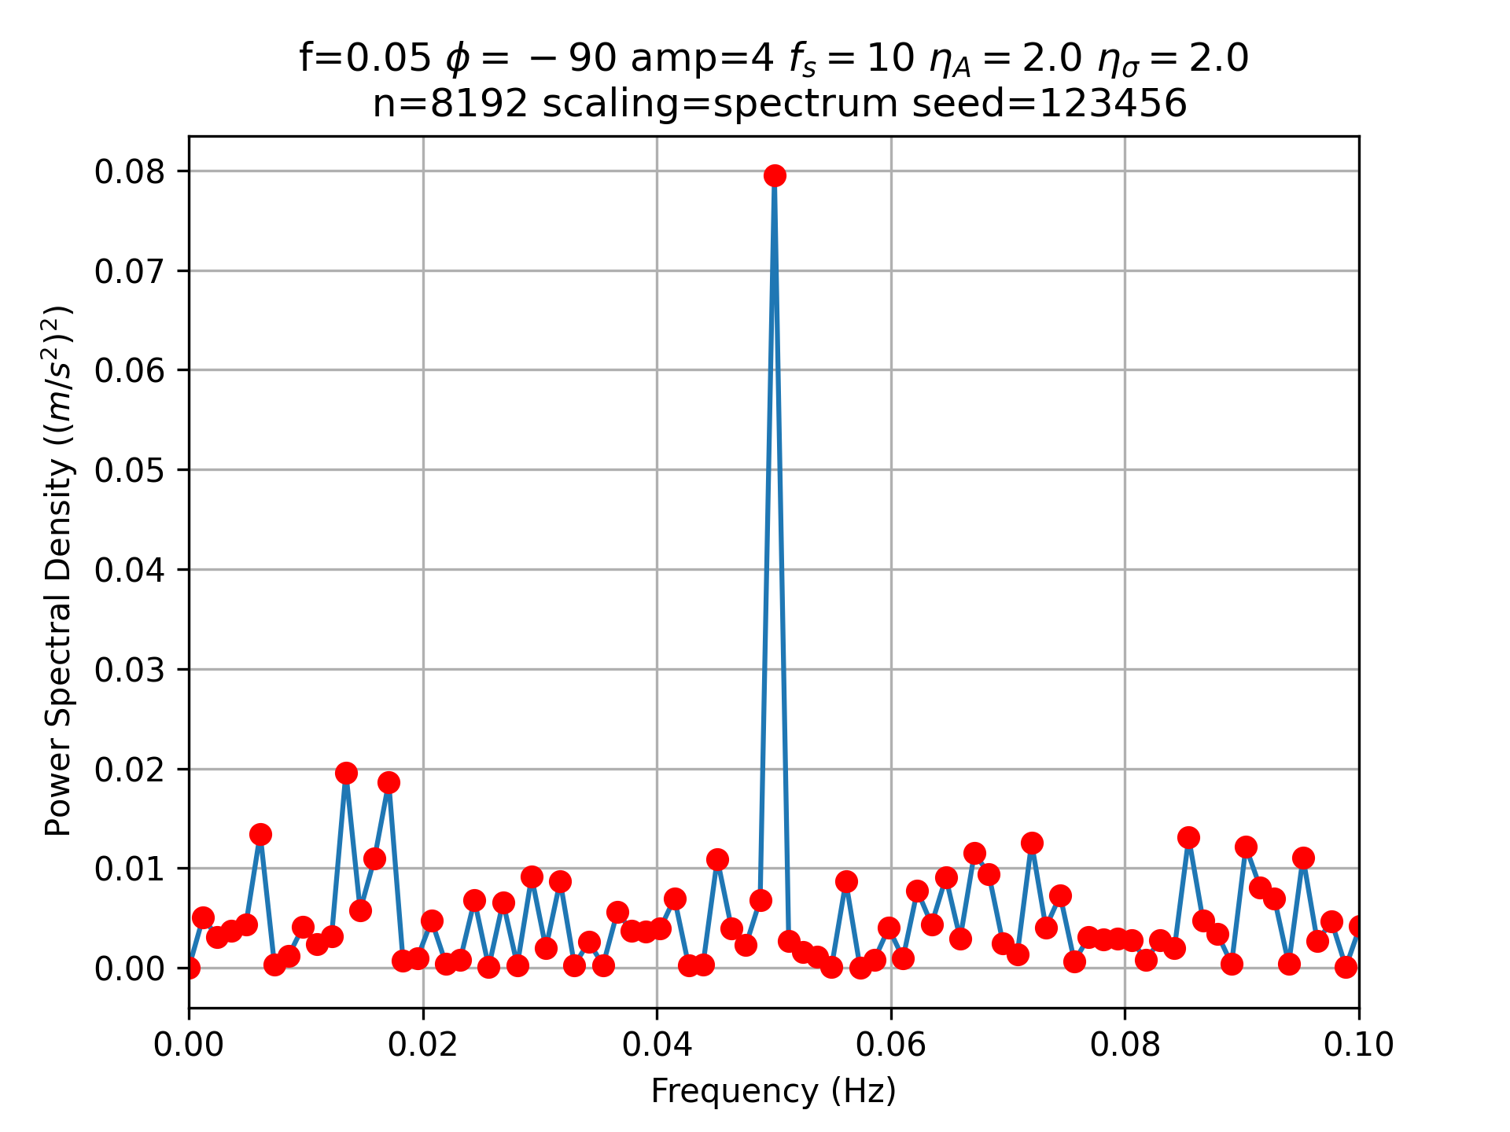
Very Noisy Periodogram
scipy.signal.periodogram

Slide 27
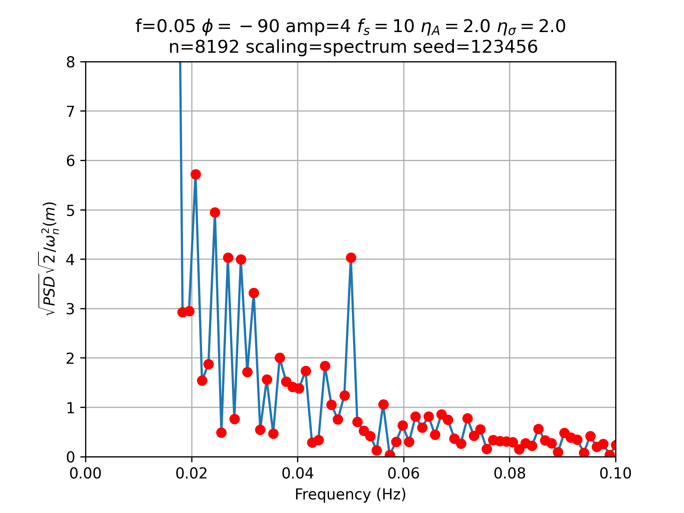
Very Noisy Periodogram Normalized
scipy.signal.periodogram

Slide 28
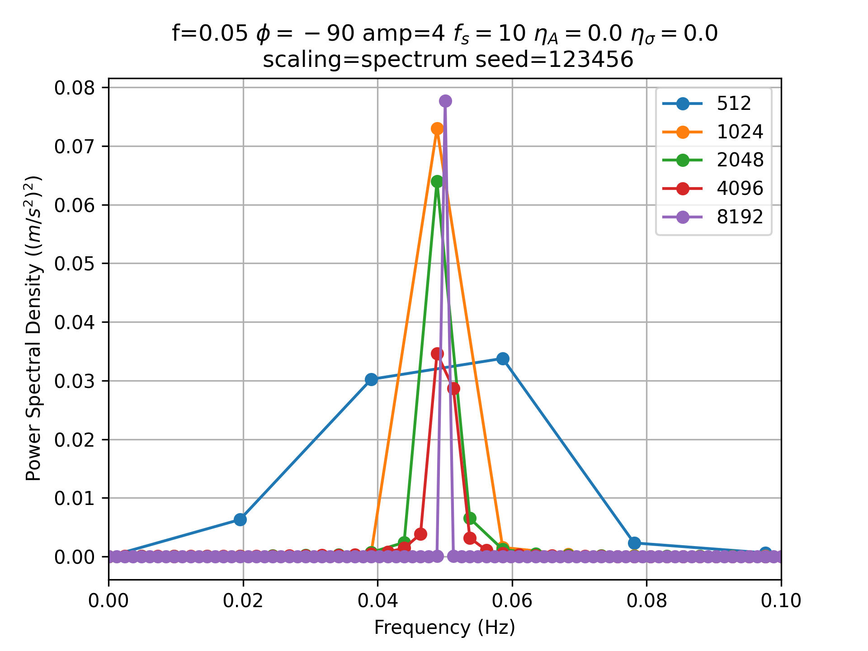
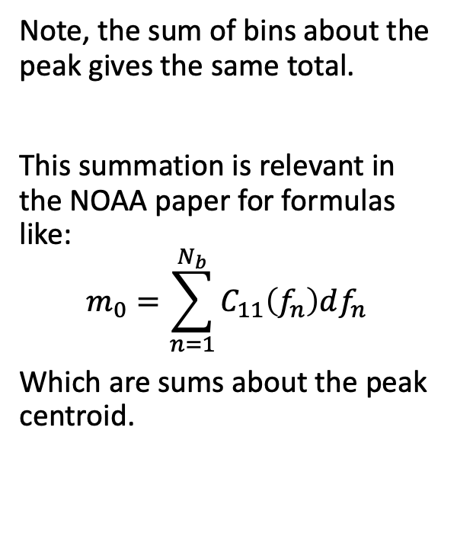
FFT Width, noiseless
Note, the sum of bins about the peak gives the same total.
This summation is relevant in the NOAA paper for formulas like:
$$m_{0}=\sum_{n=1}^{N_{b}}{C_{11}\left(f_{n}\right)df_{n}}$$
Which are sums about the peak centroid.

Slide 29
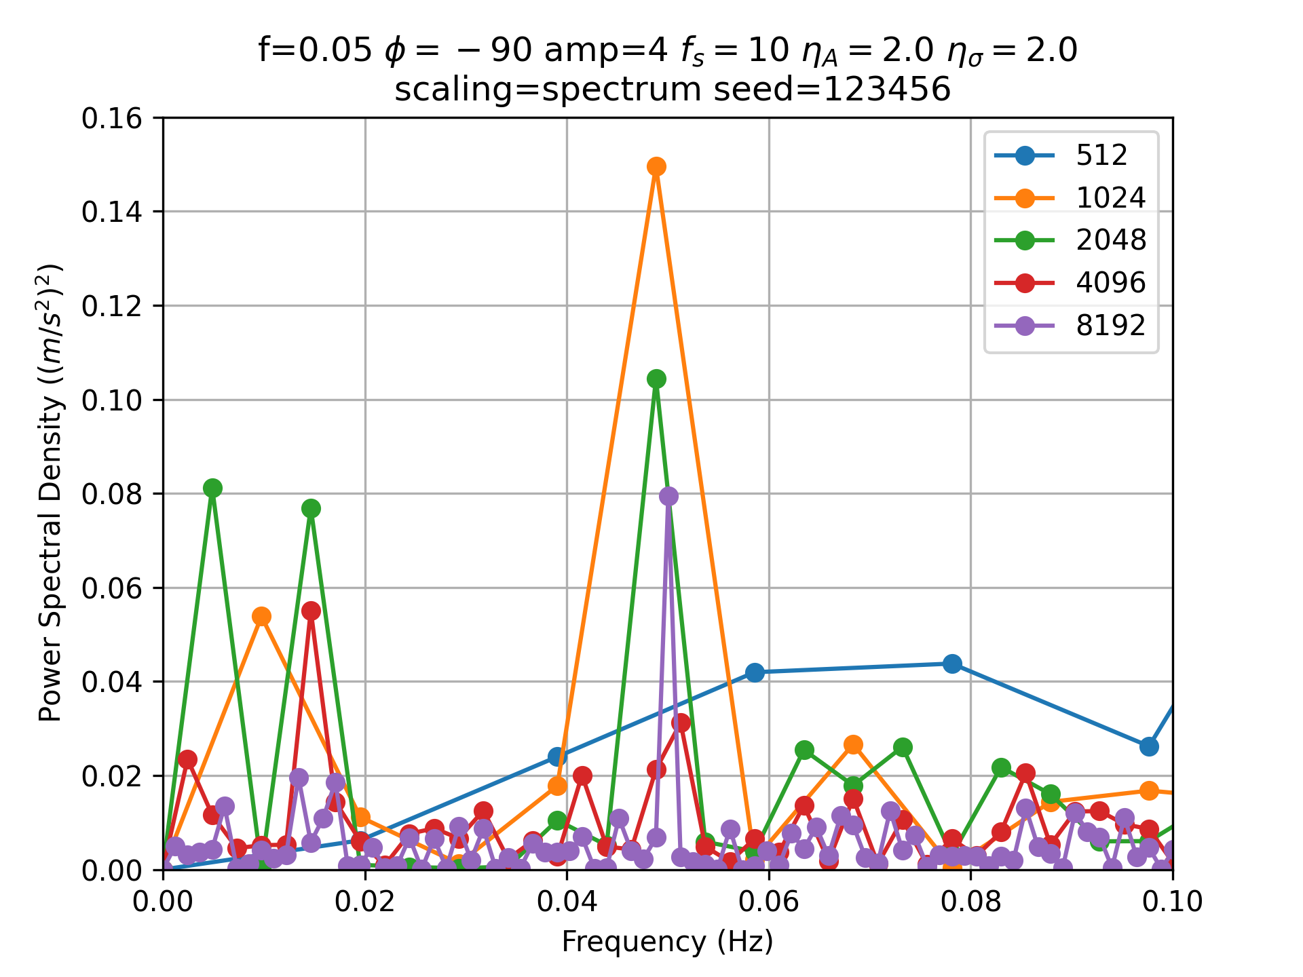
FFT Width, with noise
Note the peak heights no longer sum to ~0.078, except for the 8192 width.

Slide 30
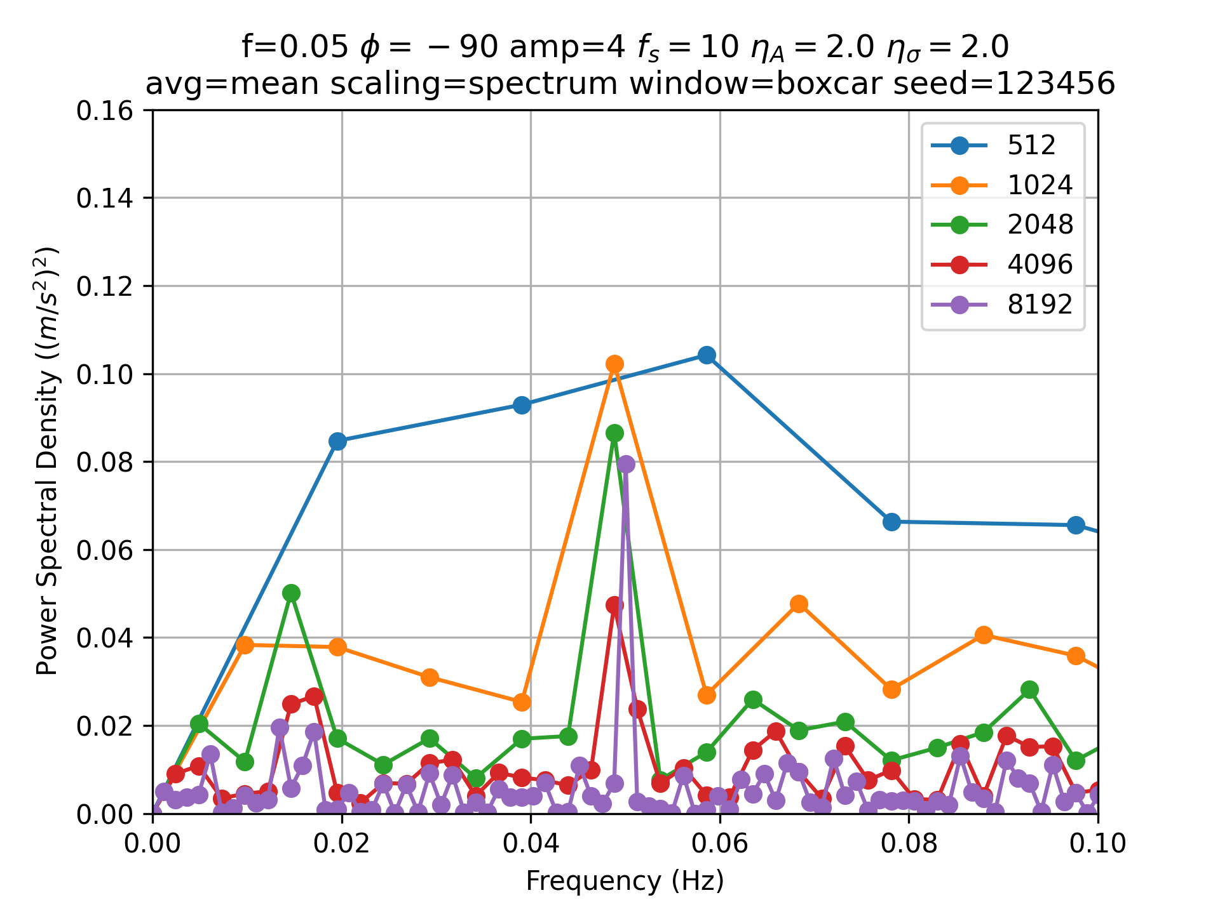
Welch’s Method
Takes multiple, possibly overlapping, samples and finds the mean PSD, but at a lower frequency resolution.
The logic here is the PSD is measuring the variance, and variances are additive.

Slide 31
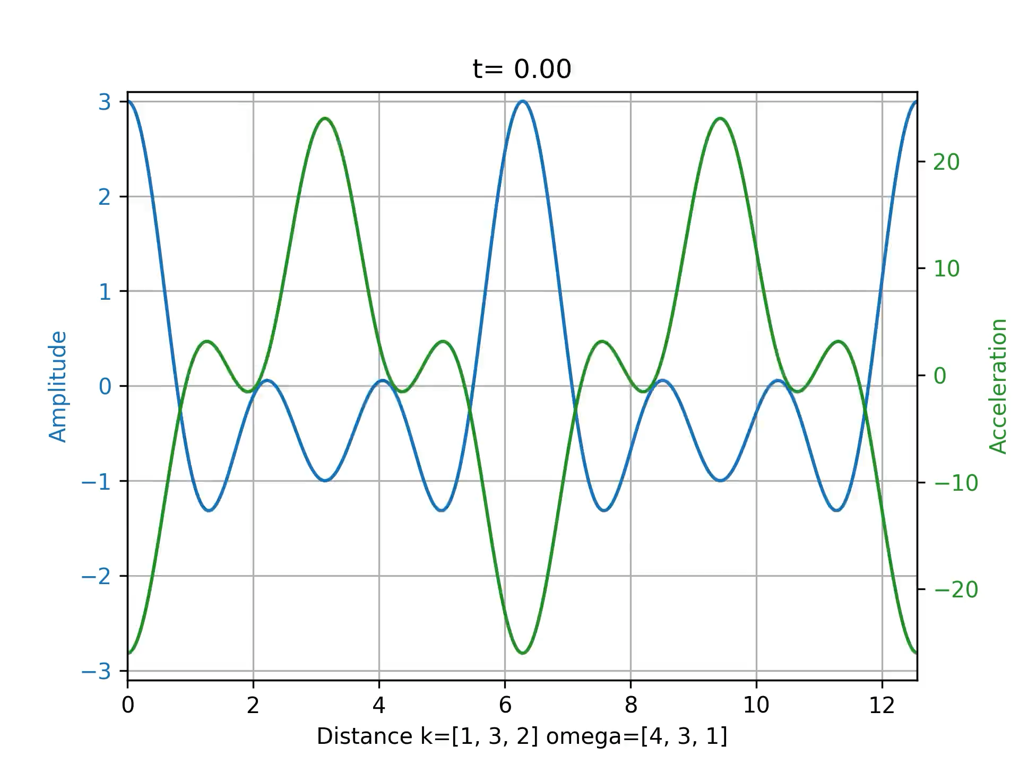
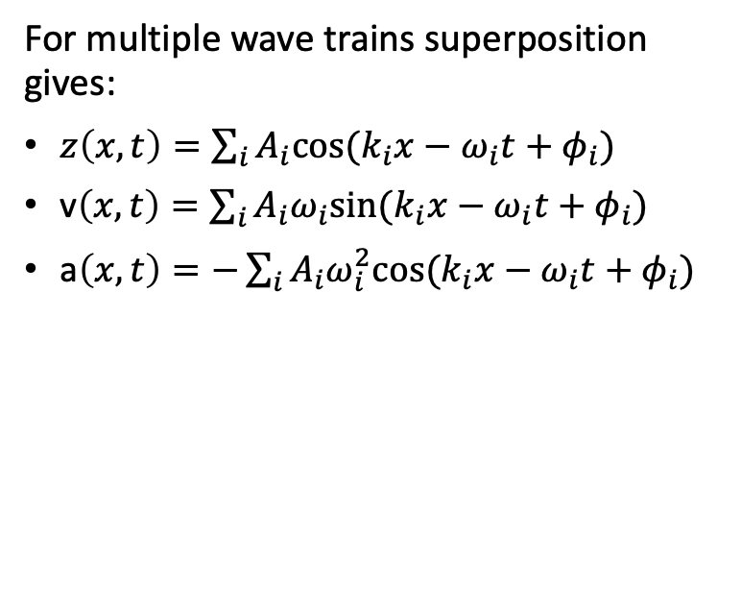
Superposition
For multiple wave trains superposition gives:
$z\left(x,t\right)=\sum_{i}{A_{i}cos⁡(k_{i}x−ω_{i}t+φ_{i})}$
v$\left(x,t\right)=\sum_{i}{A_{i}ω_{i}sin⁡(k_{i}x−ω_{i}t+φ_{i})}$
a$\left(x,t\right)=−\sum_{i}{A_{i}ω_{i}^{2}cos⁡(k_{i}x{ − ω}_{i}t+φ_{i})}$

Slide 32
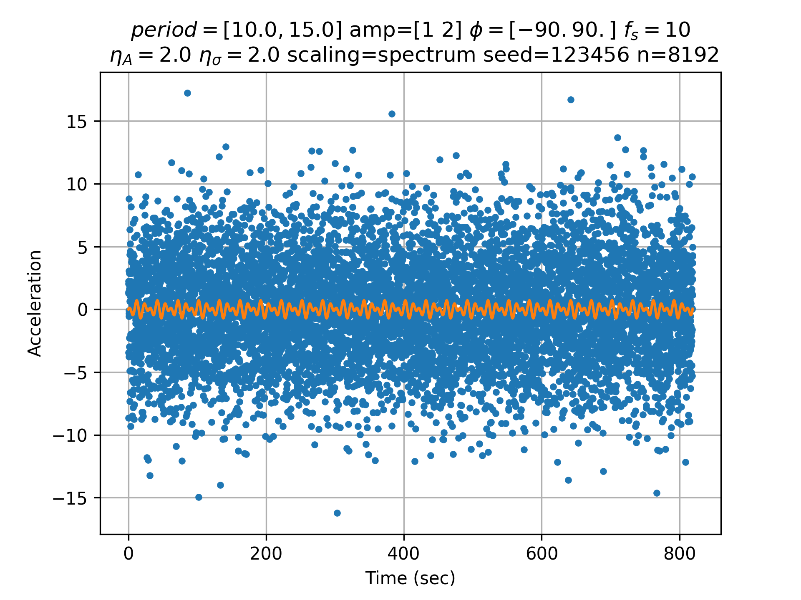
Two waves with noise

Slide 33
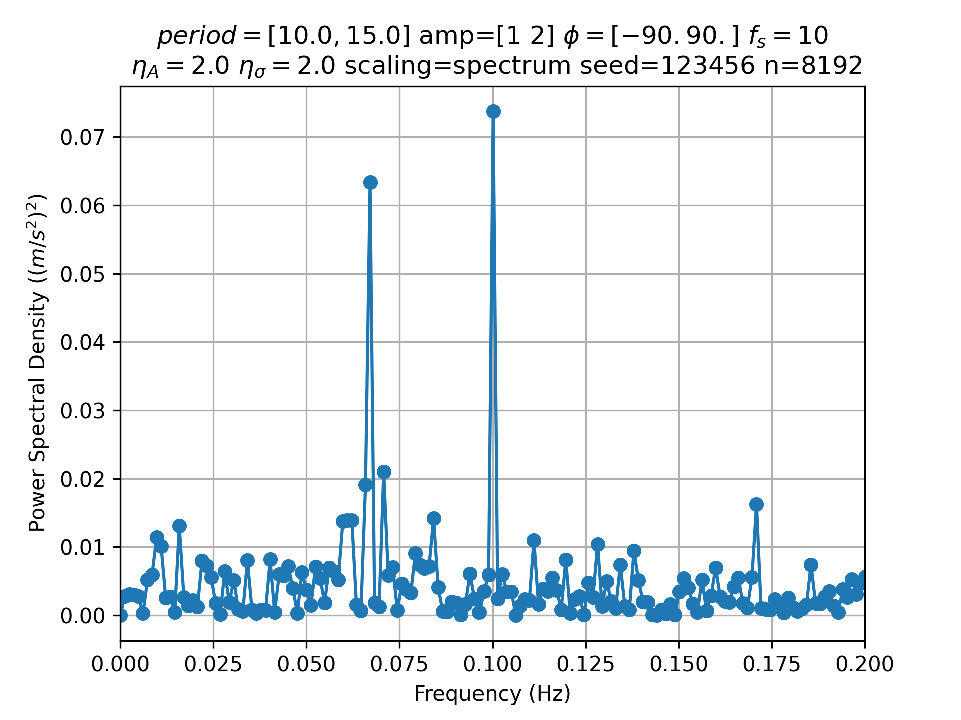
Two waves with noise
Note the two peaks are easily extracted, but the amplitudes are off due to the noise.

Slide 34
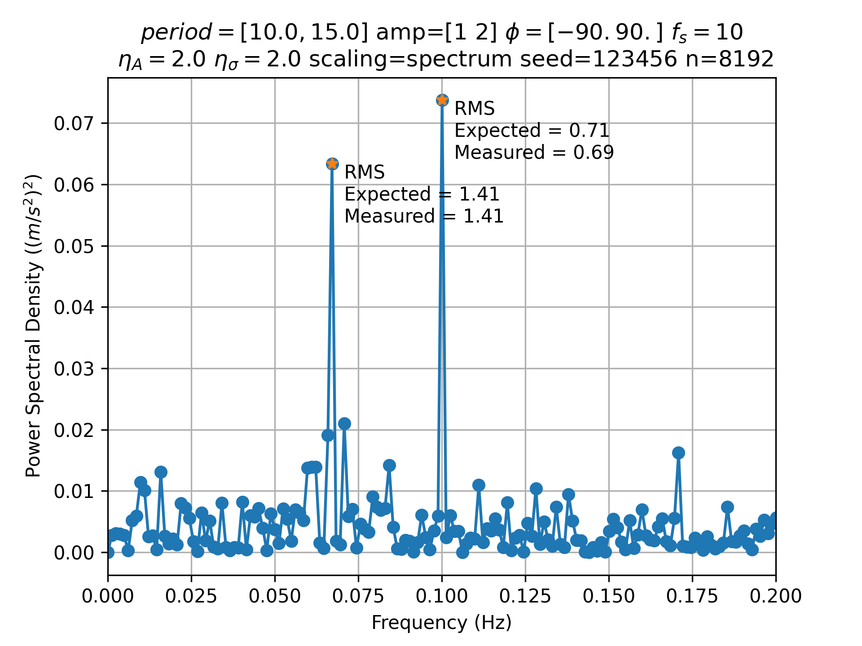
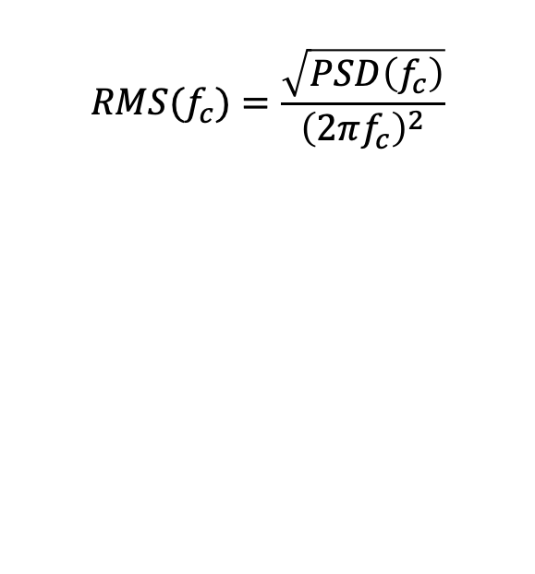
Non-directional RMS wave height
$$RMS(f_{c})=\frac{\sqrt{PSD\left(f_{c}\right)}}{{\left(2πf_{c}\right)}^{2}}$$

Slide 35
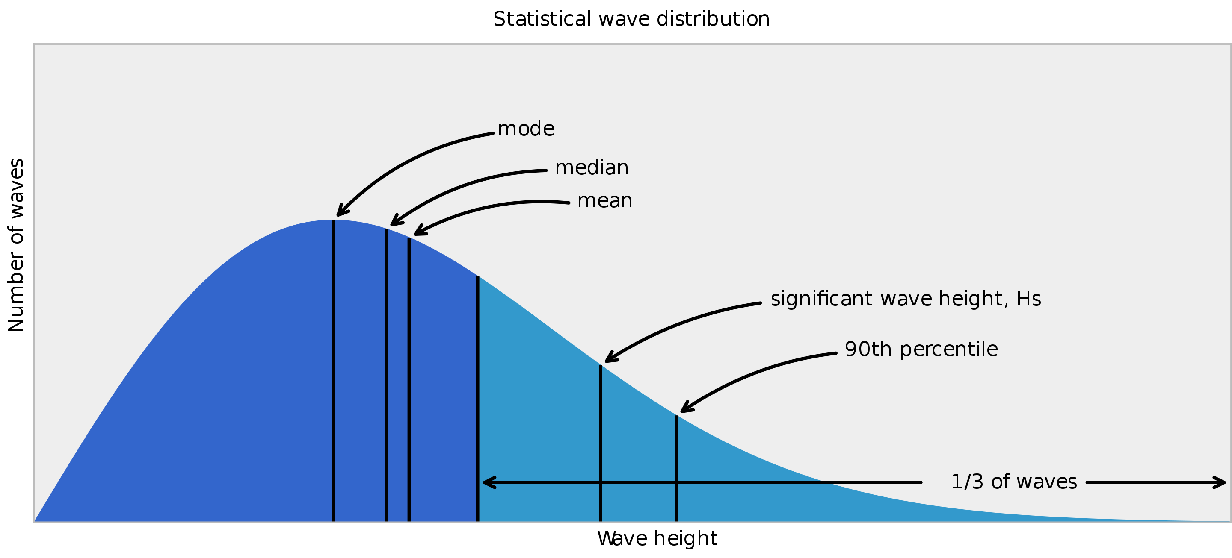
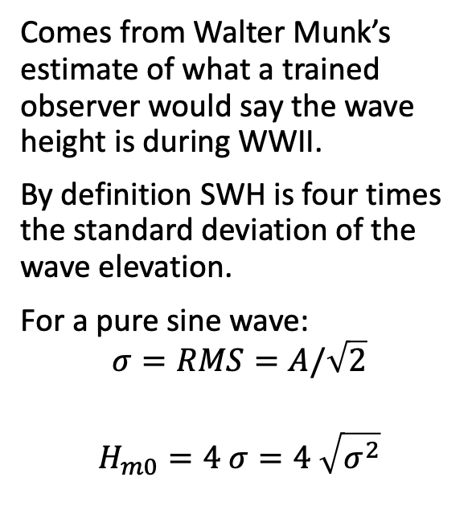
Significant Wave Height
Comes from Walter Munk’s estimate of what a trained observer would say the wave height is during WWII.
By definition SWH is four times the standard deviation of the wave elevation.
For a pure sine wave:
$$σ=RMS=A/\sqrt{2}$$
$$H_{m0}=4 σ=4 \sqrt{σ^{2}}$$

Slide 36

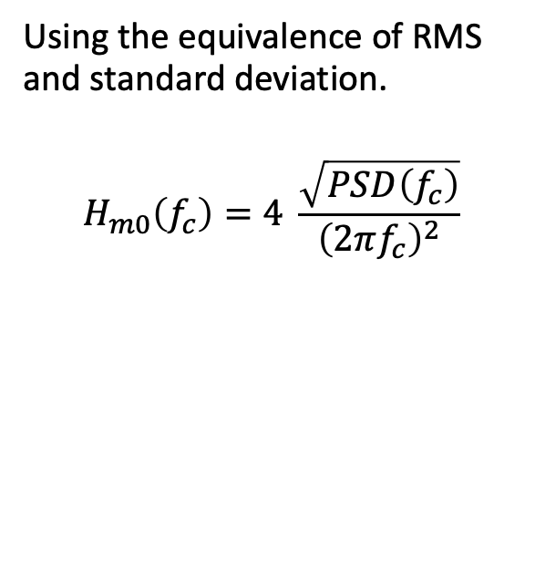
Significant Wave Height
Using the equivalence of RMS and standard deviation.
$$H_{m0}\left(f_{c}\right)=4 \frac{\sqrt{PSD\left(f_{c}\right)}}{{\left(2πf_{c}\right)}^{2}}$$

Slide 37
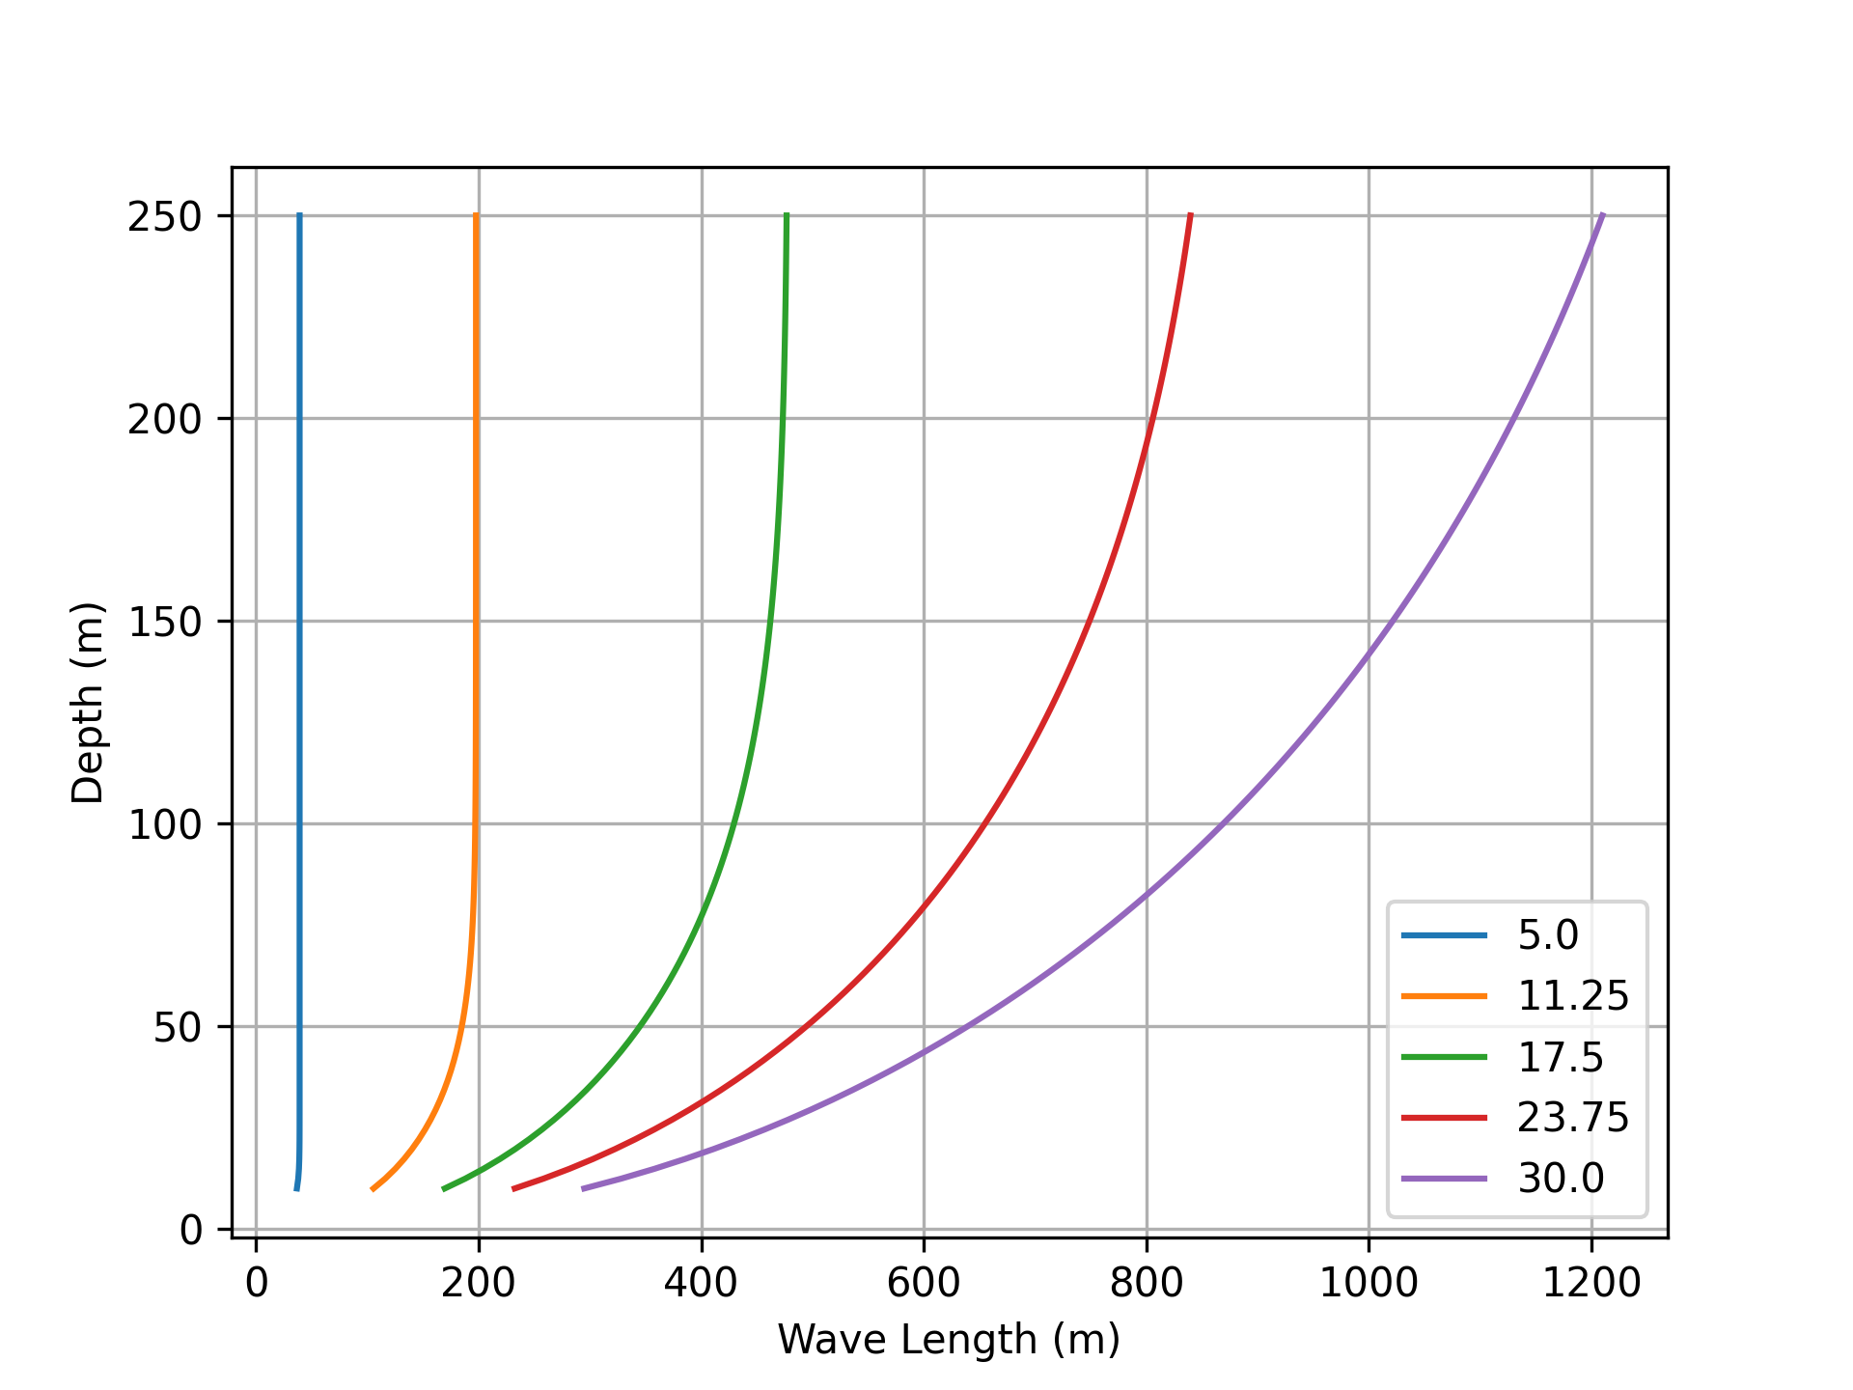
Wave Length versus depth
As the depth increases, the ocean wave length increases

Slide 38
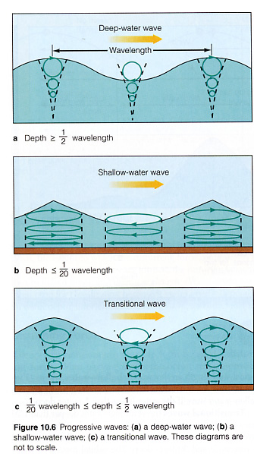
Horizontal Motion
In reality, a water parcel does not just move up and down. It is also translated forwards and backwards in the direction of the wave.
See: http://web.mit.edu/13.021/demos/lectures/lecture19.pdf

Slide 39
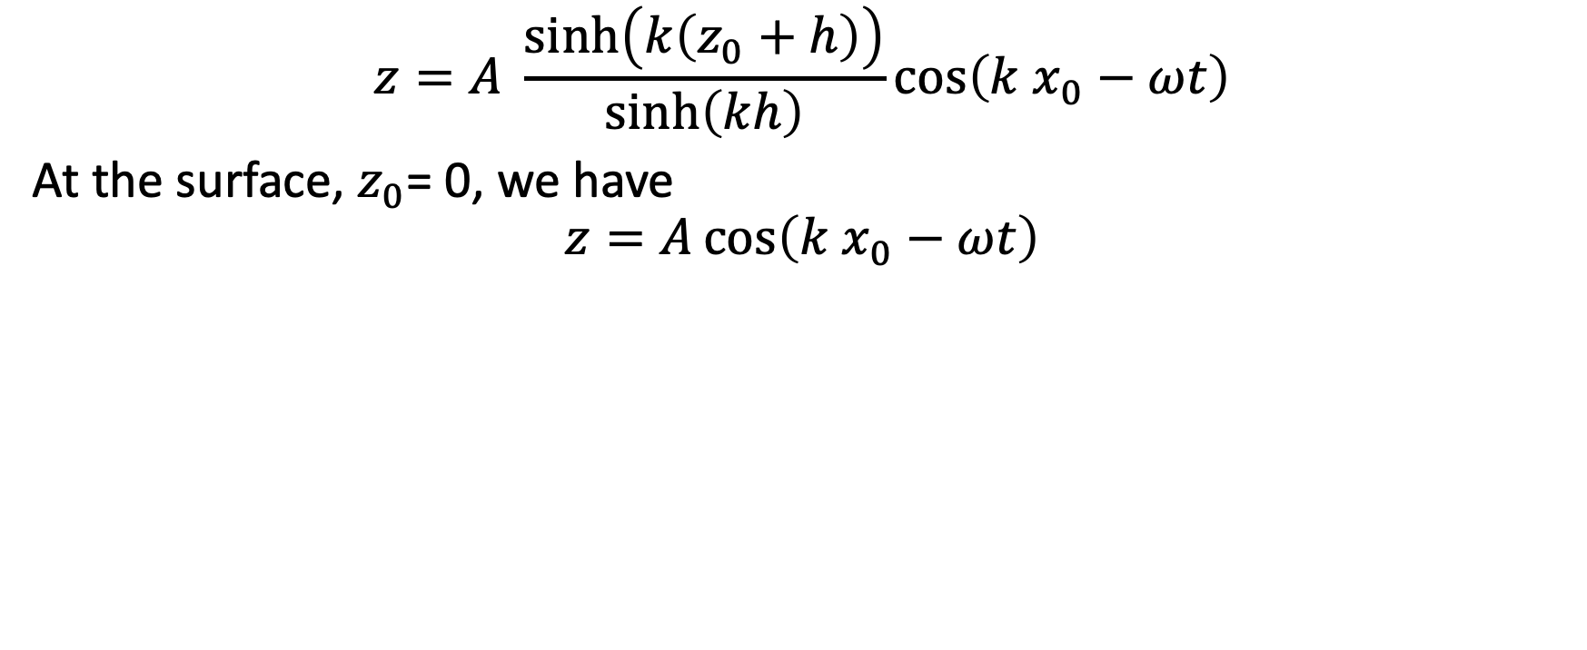
Vertical motion:
$$z=A \frac{\sinh\left(k\left(z_{0}+h\right)\right)}{\sinh\left(kh\right)}\cos\left(k x_{0}−ωt\right)$$
At the surface, $z_{0}$= 0, we have
$$z=A\cos\left(k x_{0}−ωt\right)$$

Slide 40
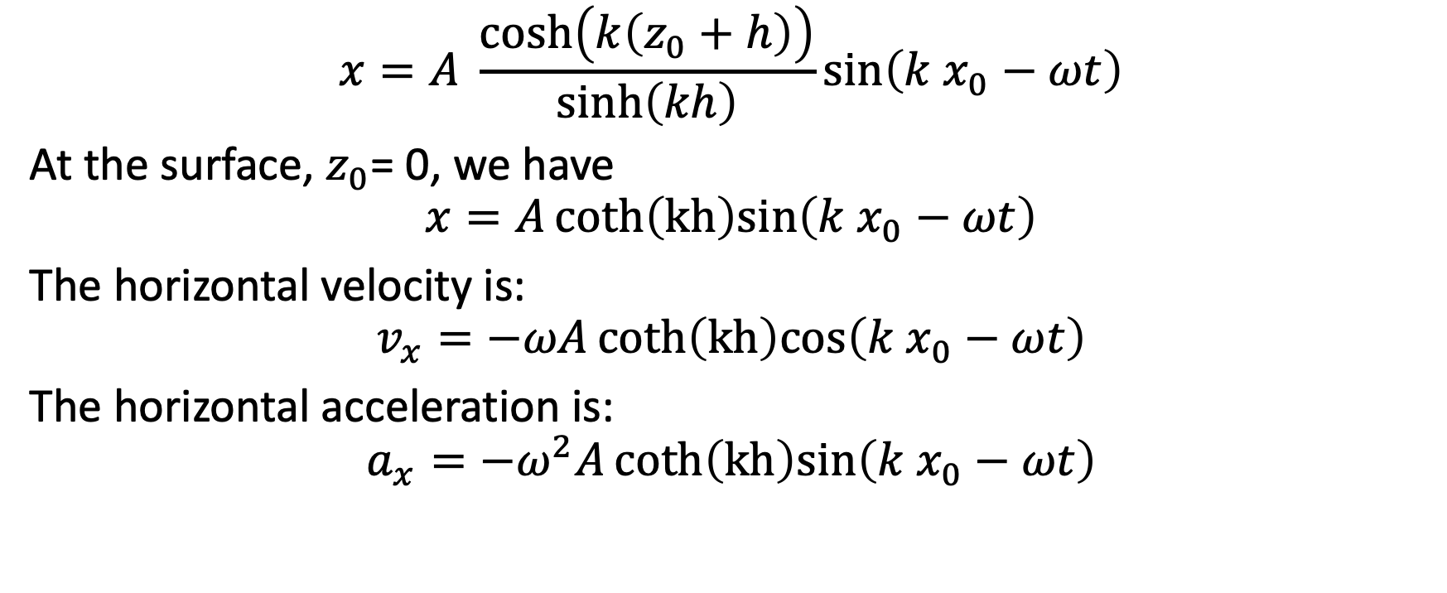
Horizontal motion:
$$x=A \frac{\cosh\left(k\left(z_{0}+h\right)\right)}{\sinh\left(kh\right)}\sin\left(k x_{0}−ωt\right)$$
At the surface, $z_{0}$= 0, we have
$$x=Acoth\left(kh\right)sin\left(k x_{0}−ωt\right)$$
The horizontal velocity is:
$$v_{x}=−ωAcoth\left(kh\right)cos\left(k x_{0}−ωt\right)$$
The horizontal acceleration is:
$$a_{x}=−ω^{2}Acoth\left(kh\right)sin\left(k x_{0}−ωt\right)$$

Slide 41
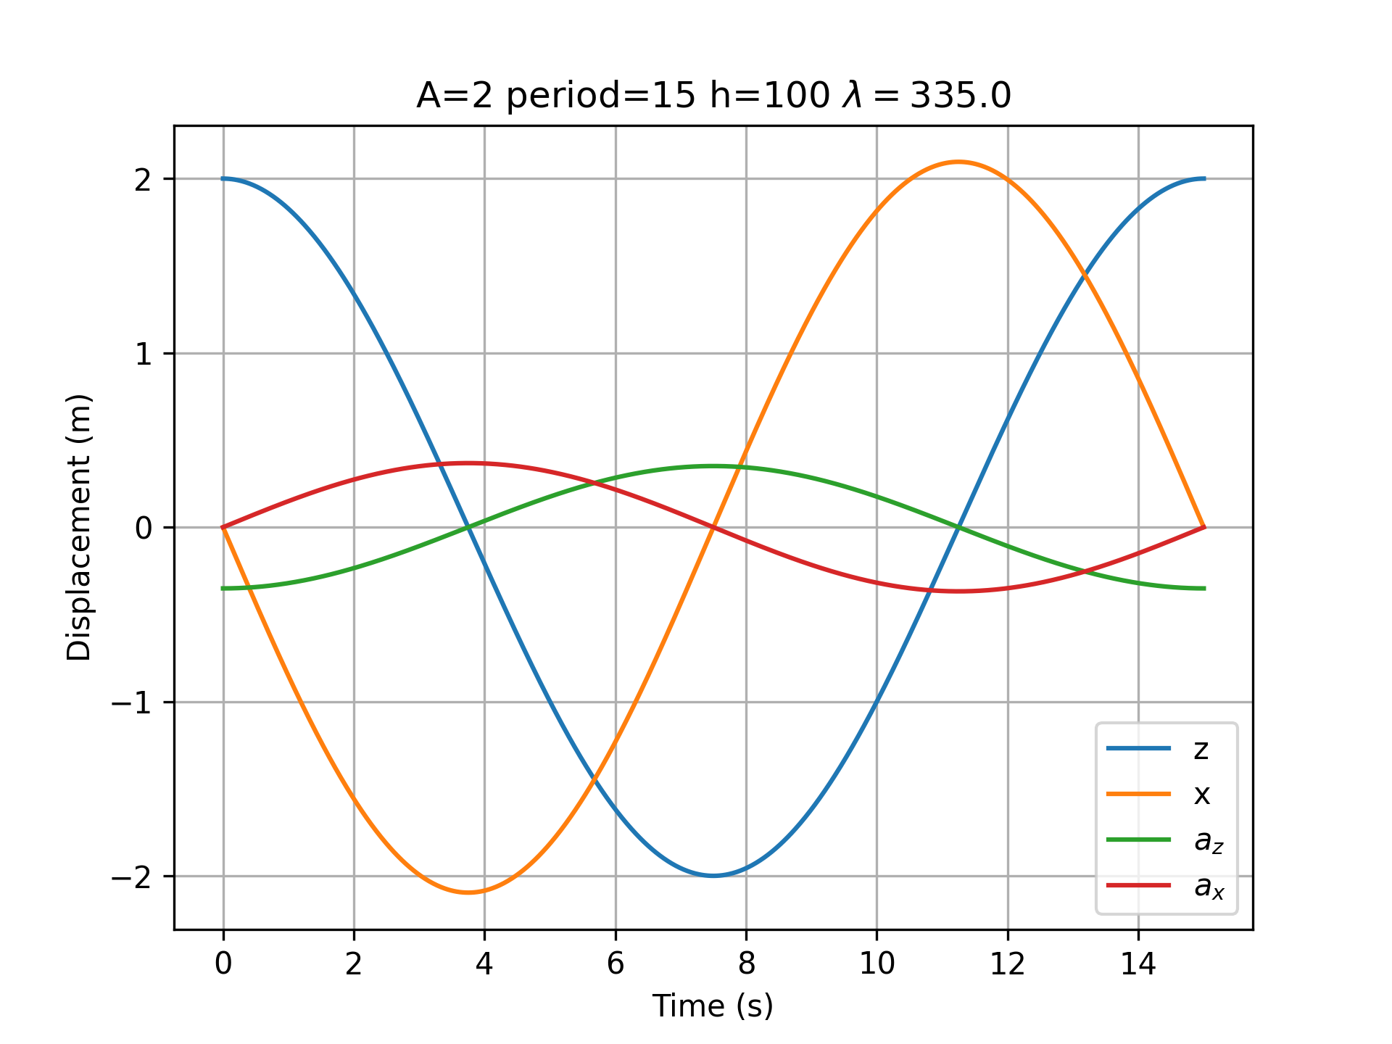
Sample Wave Motion

Slide 42

Wave Direction
If we can measure the relative amplitude of the two horizontal directions, we can use the trigonometry via the arc tangent to determine the direction. We need to find the along wave motion in two directions. We get these by looking at the Cross Spectral Density:
$$S_{xy}=\frac{FFT_{x}^{∗}FFT_{y}}{L Δt}$$
I’ll use scipy.signal.csd

Slide 43

Wave Height Generalized
We can generalize direction of the wave using a vector form of k and x.
$$z\left(\vec{x},t,\vec{k},ω\right)=A\cos\left(\vec{k} ⋅\vec{x} −ωt+φ\right)$$
Where $\vec{k}$ and $\vec{x}$are two dimensional vectors

